Slide 1
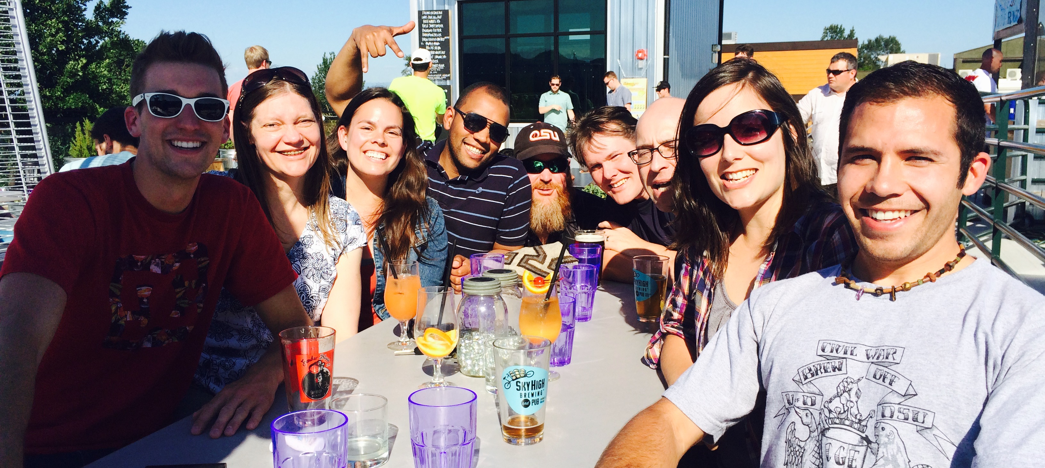




Slide 2
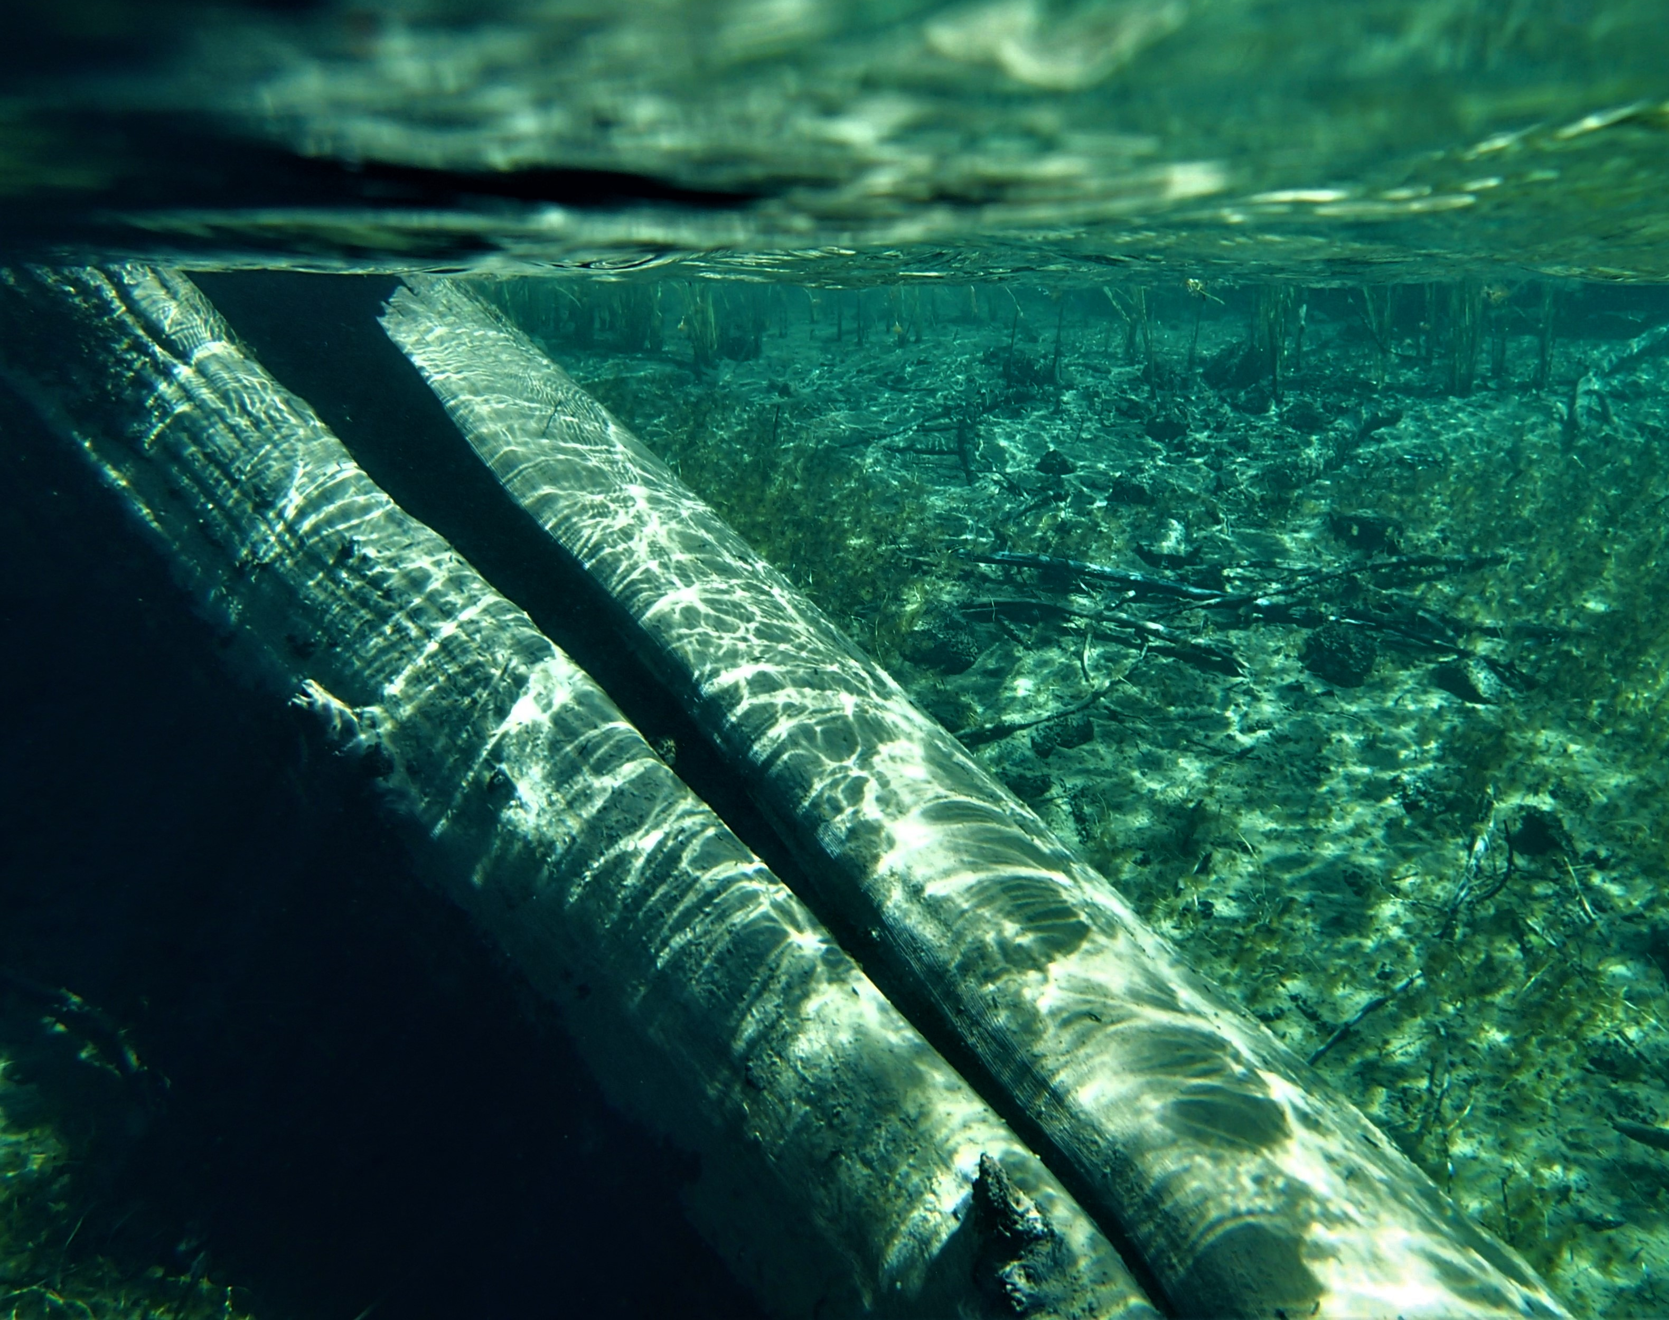
Should we bury our forests in the bottom of the ocean?
Francisco J. Guerrero, PhD
College of Forestry
Oregon State University
@fjguerrerob
guerrero.Francisco.jose@gmail.com

Slide 3
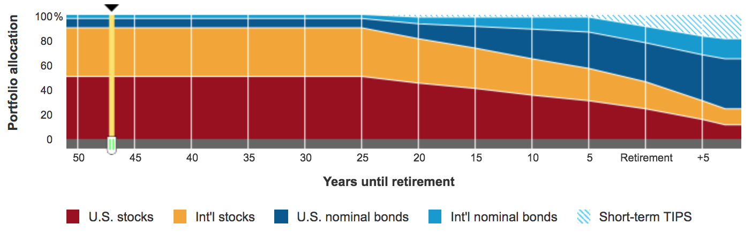
How to retire amid climate change?
https://www.snideradvisors.com/blog/the-importance-of-asset-allocation/

Slide 4
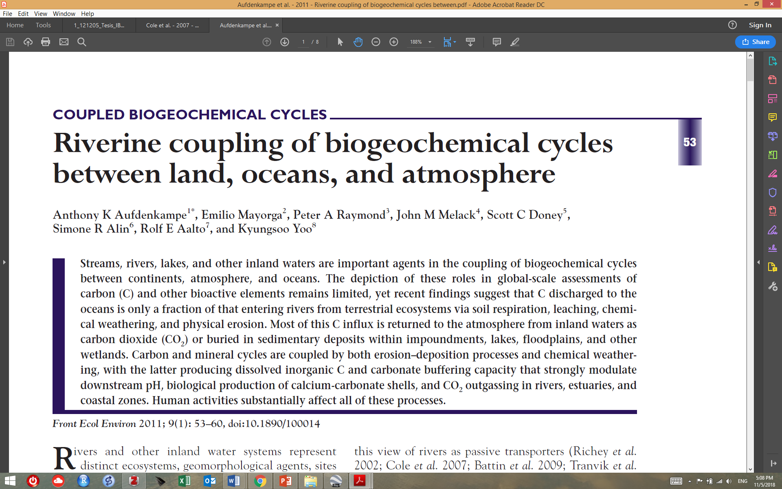
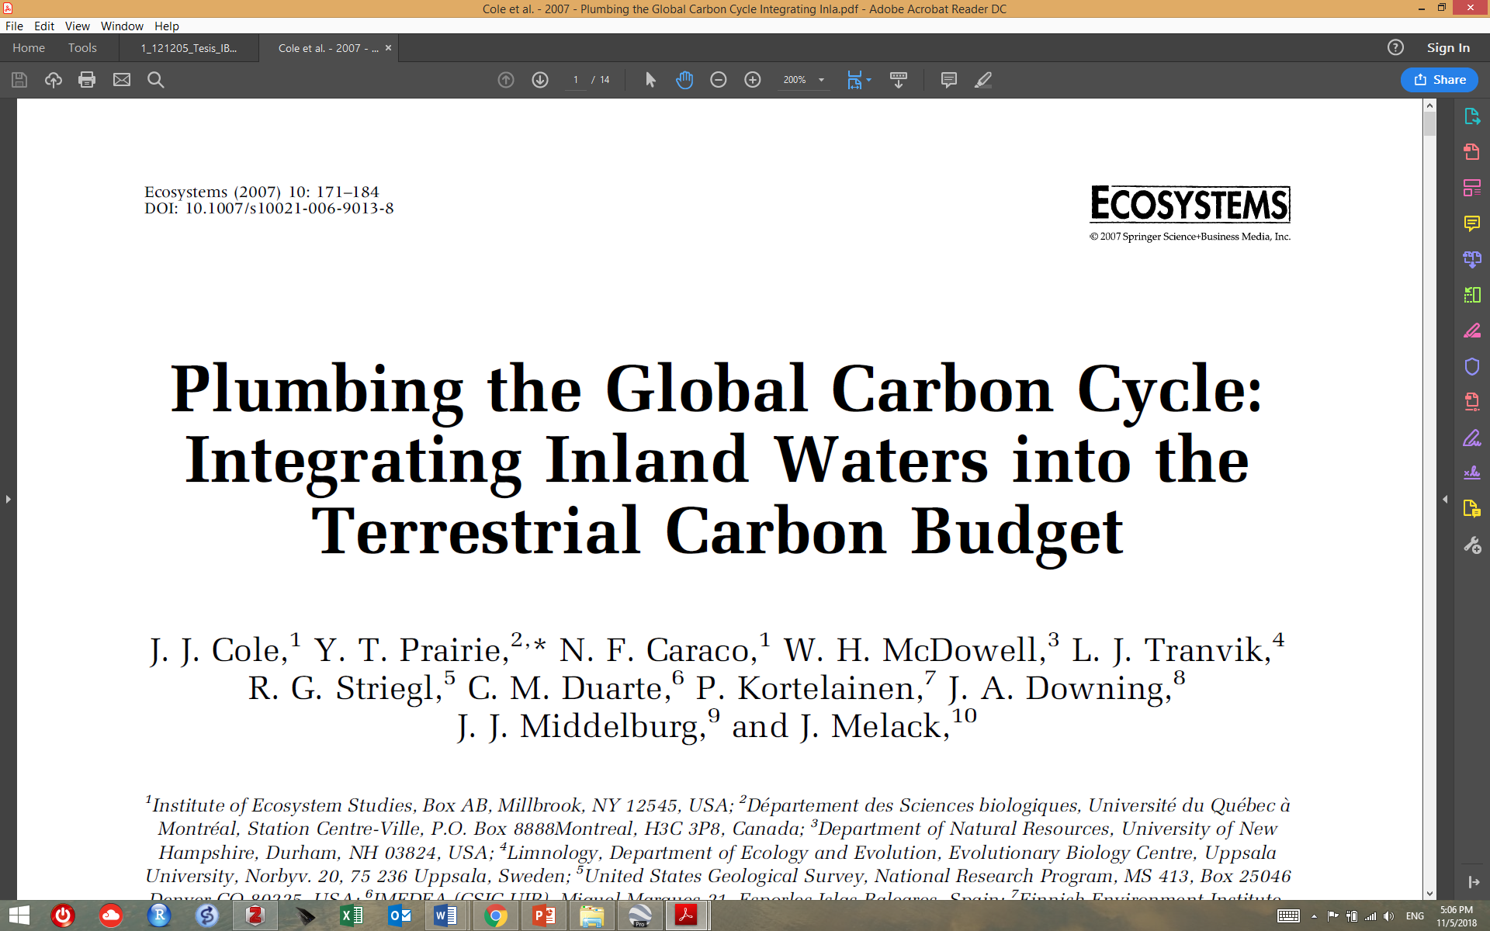
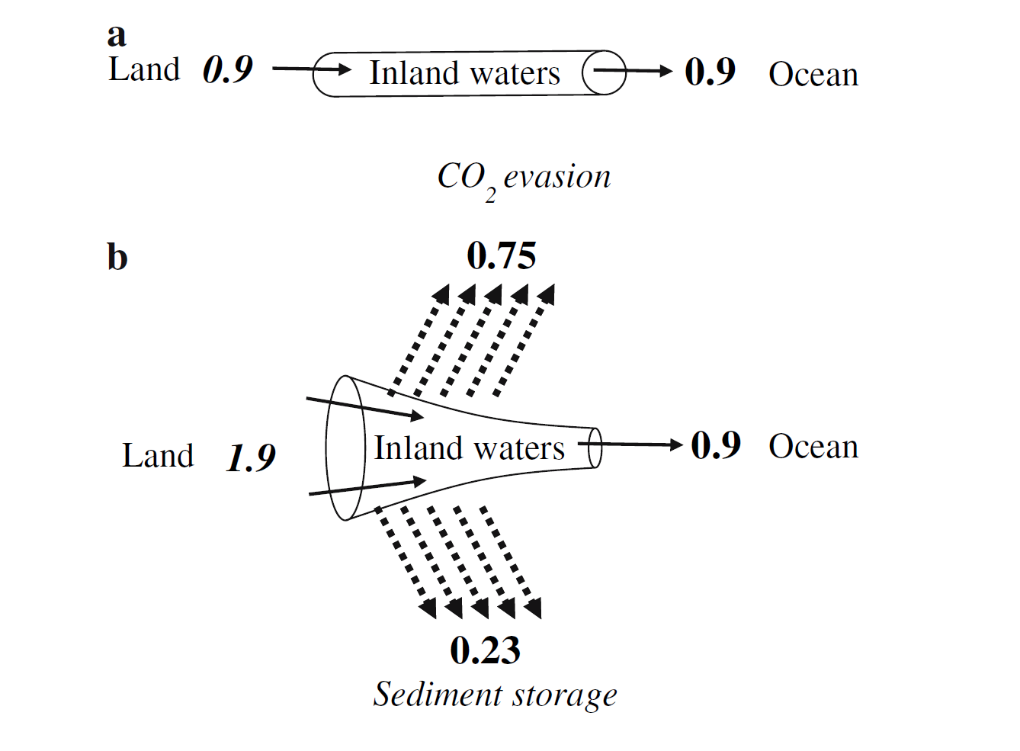
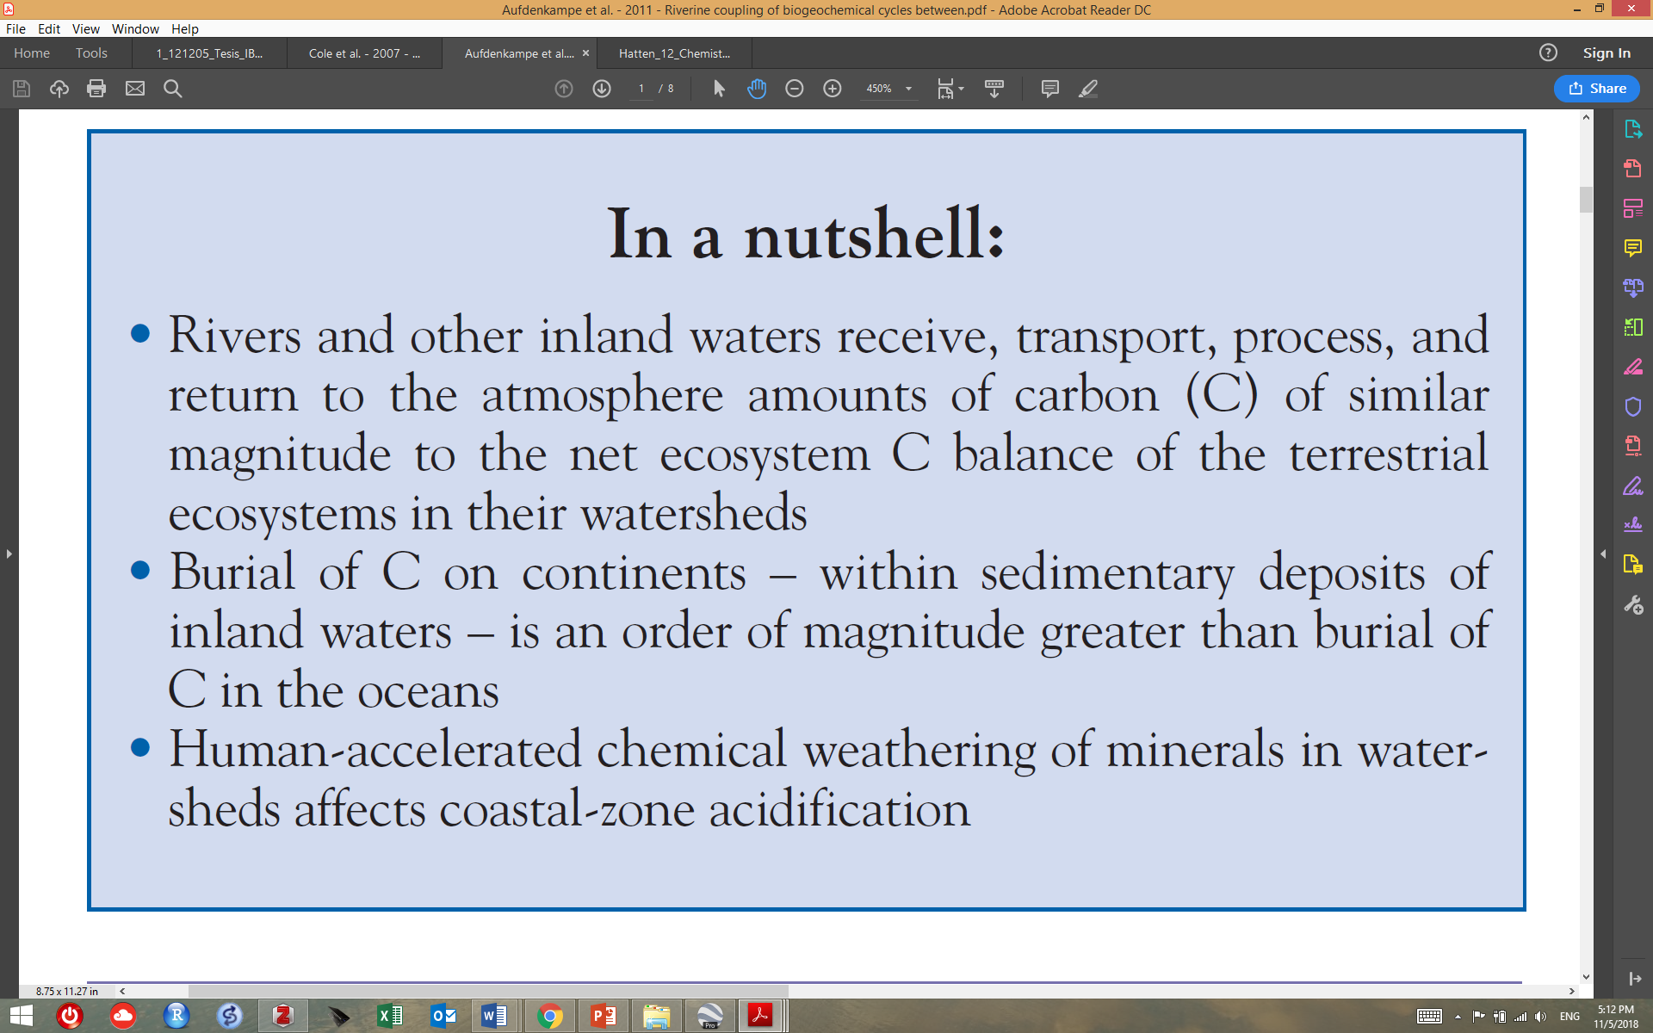

Slide 5
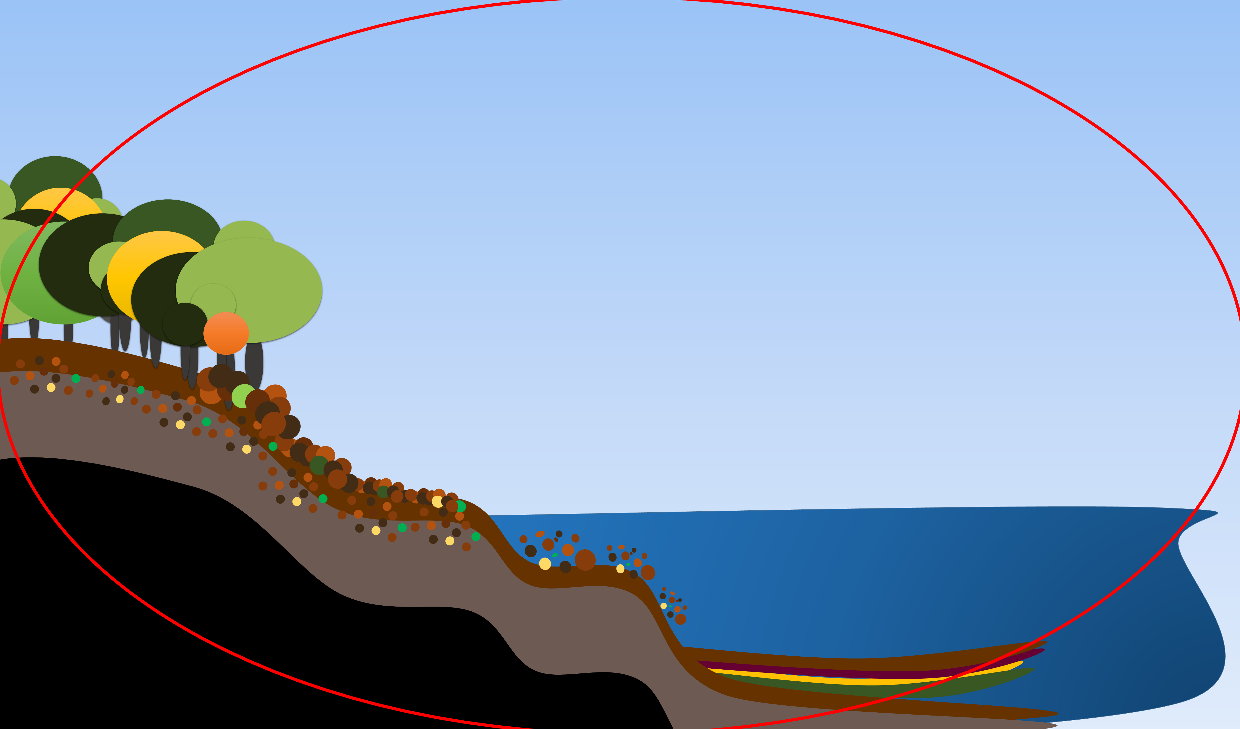
Terrestrial-aquatic carbon fluxes in forested watersheds
The Global Bio-Geochemical Cycle of Carbon
Photosynthesis
Atmosphere
Years
Burning
fossil fuels
Forests
Soils
Plant & soil erosion
Carbon
Respiration
Rivers
Lakes/Oceans
Bedrock
Rock erosion
Deposition
Millions of Years
Uplift
Sediment
Carbon
Subduction

Slide 6
The Global Bio-Geochemical Carbon Cycle
Photo-
synthesis
Atmosphere
Years
Burning
fossil fuels
Forests
Soils
Plant & soil erosion
Carbon
Respiration
Rivers
Lakes/Oceans
Bedrock
Rock erosion
Deposition
Millions of Years
Uplift
Sediments
Carbon
Subduction
By F. Guerrero

Slide 9
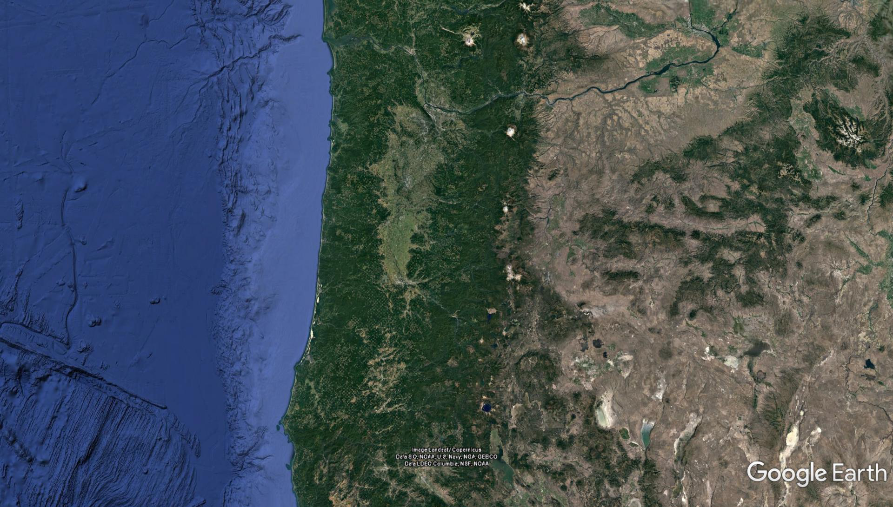
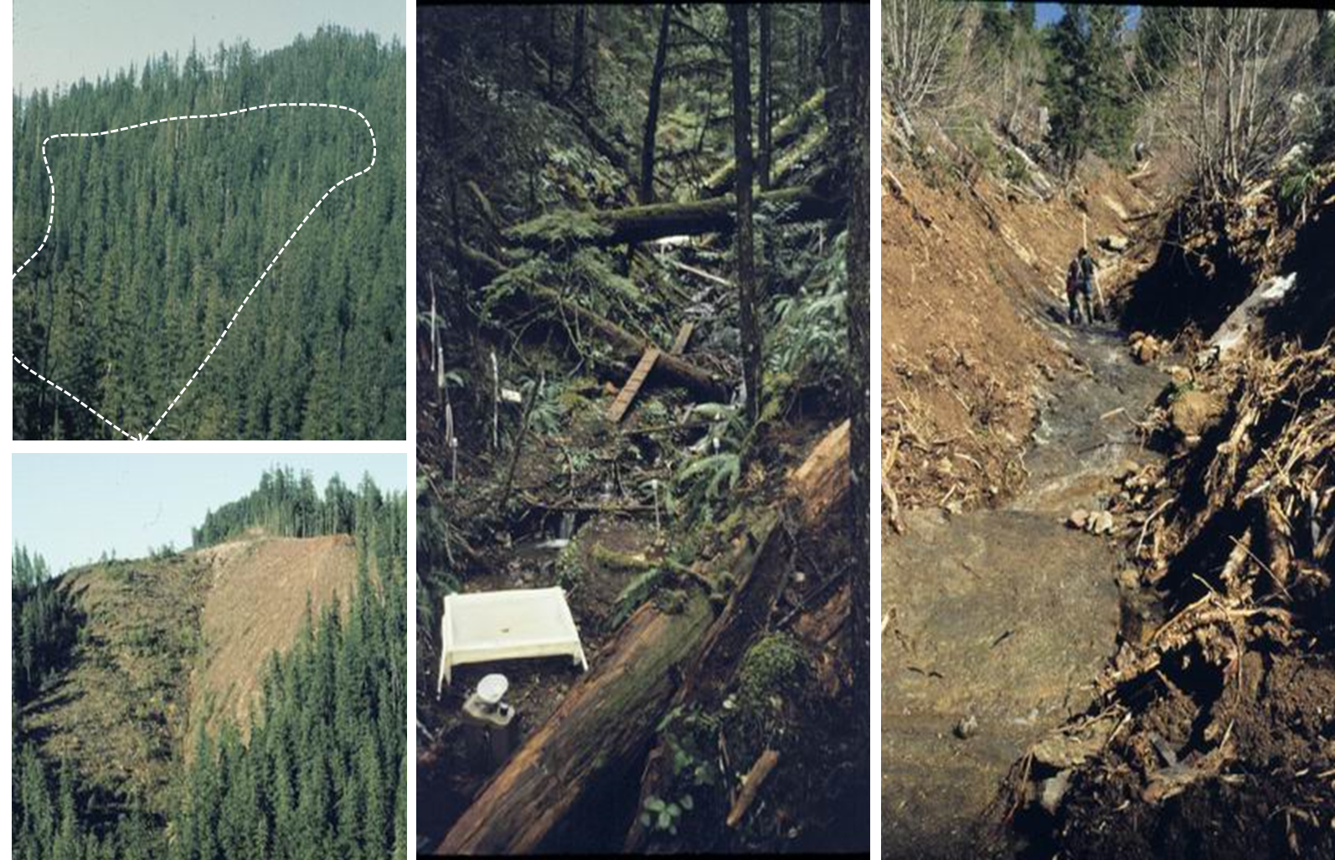
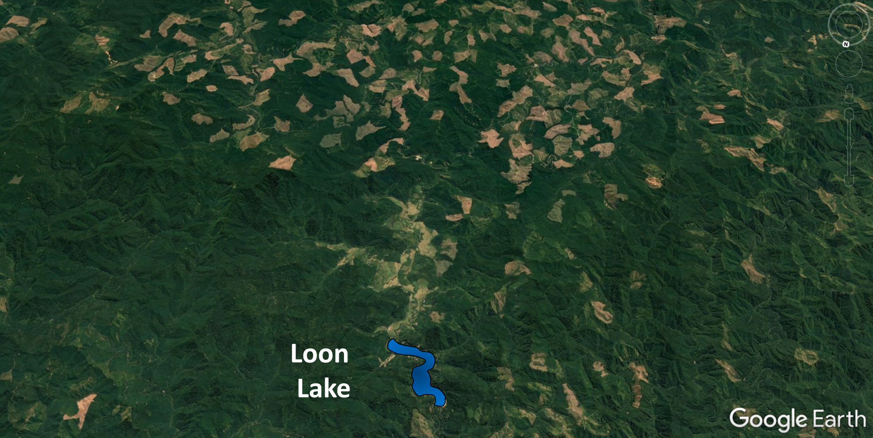
Small Mountainous Rivers: Disproportionately large exporters of Biospheric C
Hatten et al., 2012; Goni et al., 2013;
Hilton et al., 2017
WASHINGTON
Willamette Valley
OREGON
TIMBER
HARVESTING
Photographs by Fred Swanson-Andrews Forest Image Library (H. J. Andrews Experimental Forest)

Slide 10
Small Mountainous Rivers: Disproportionately large exporters of Biospheric C
Hatten et al., 2012; Goni et al., 2013;
Hilton et al., 2017
WASHINGTON
Willamette Valley
OREGON
TIMBER
HARVESTING
Photographs by Fred Swanson-Andrews Forest Image Library (H. J. Andrews Experimental Forest)

Slide 11
Terrestrial-aquatic carbon fluxes in forested watersheds
The Global Bio-Geochemical Cycle of Carbon
Atmosphere
Photo-
synthesis
Respiration
Plant & soil erosion
Carbon
Rivers
Lakes/Oceans
Rock erosion
Deposition
Bedrock
Sediments
Carbon

Slide 12
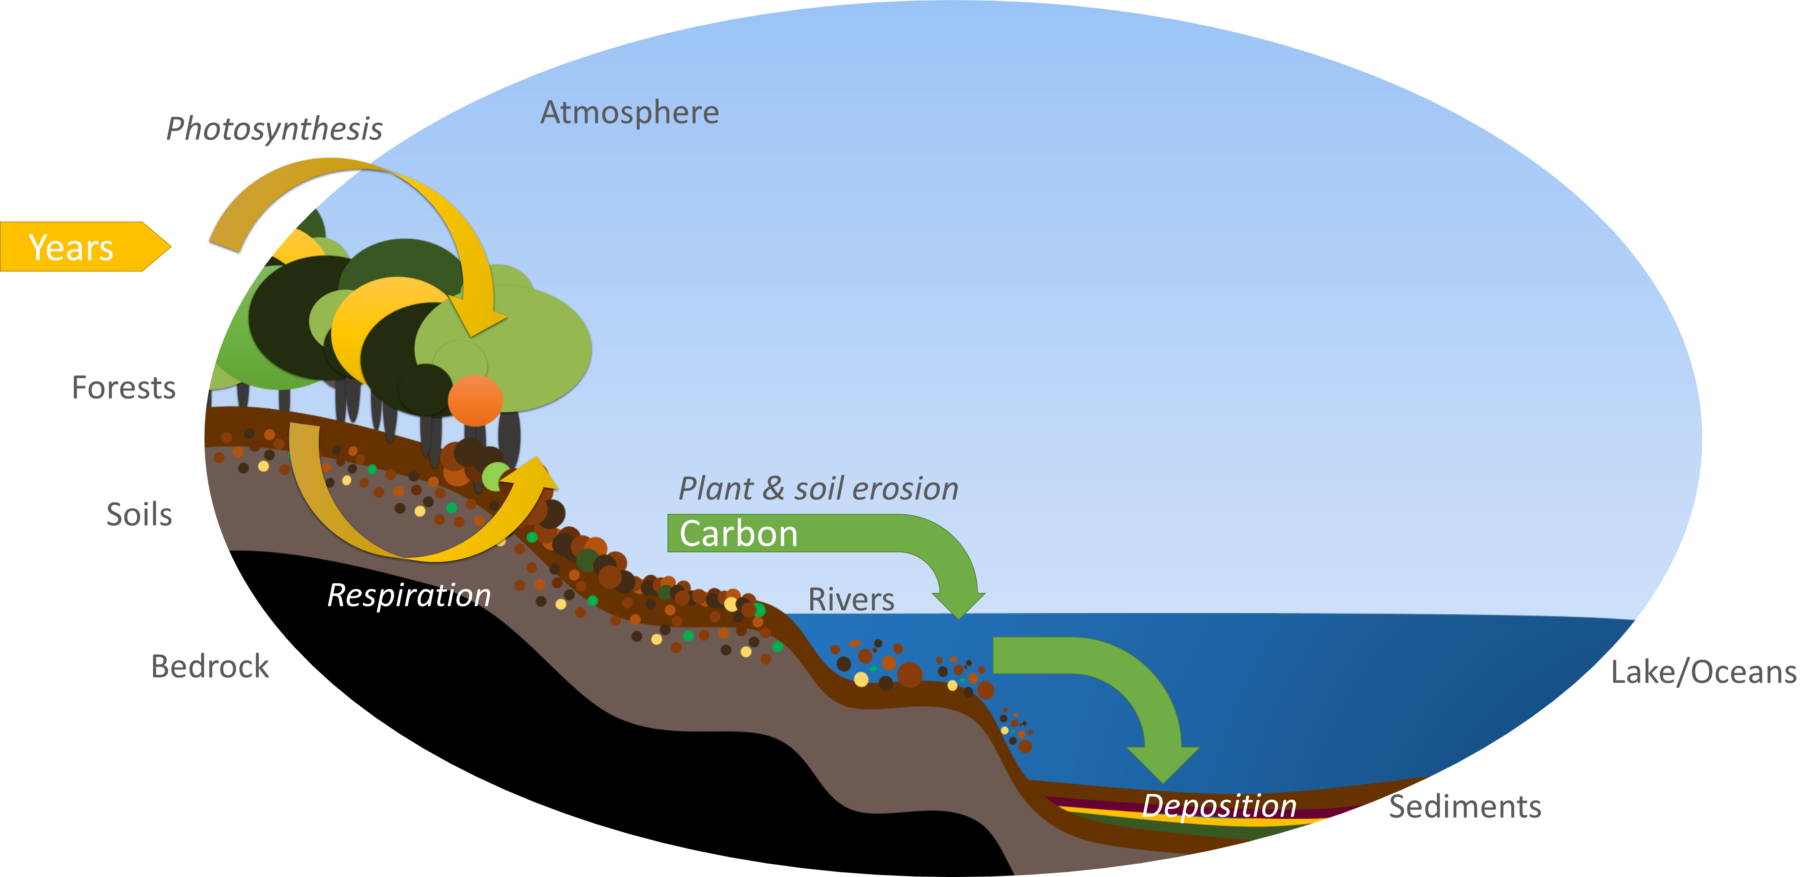
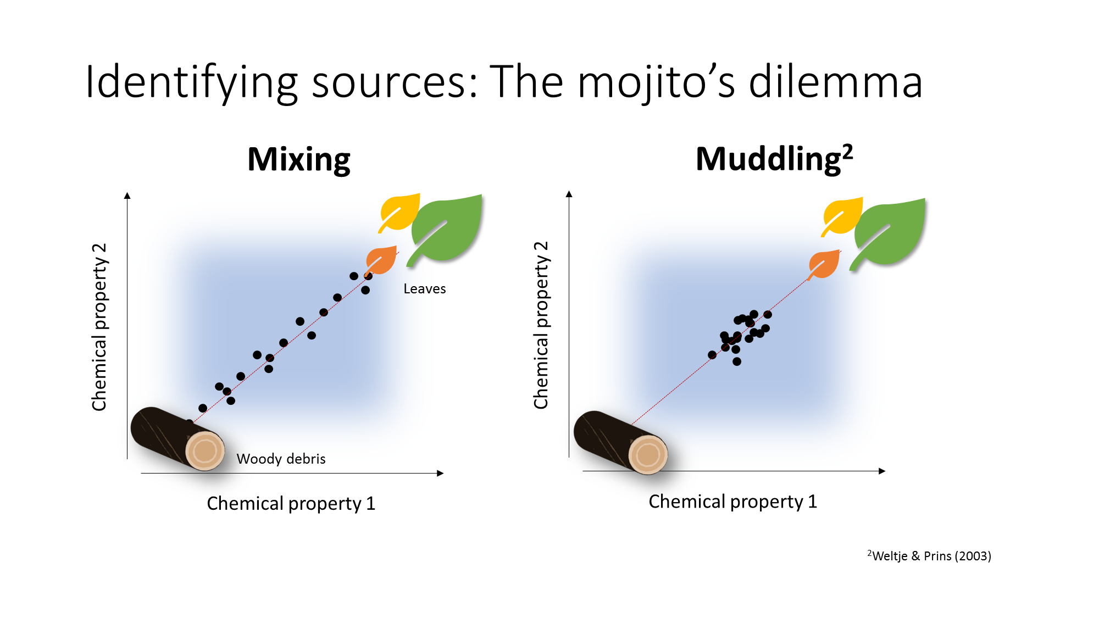
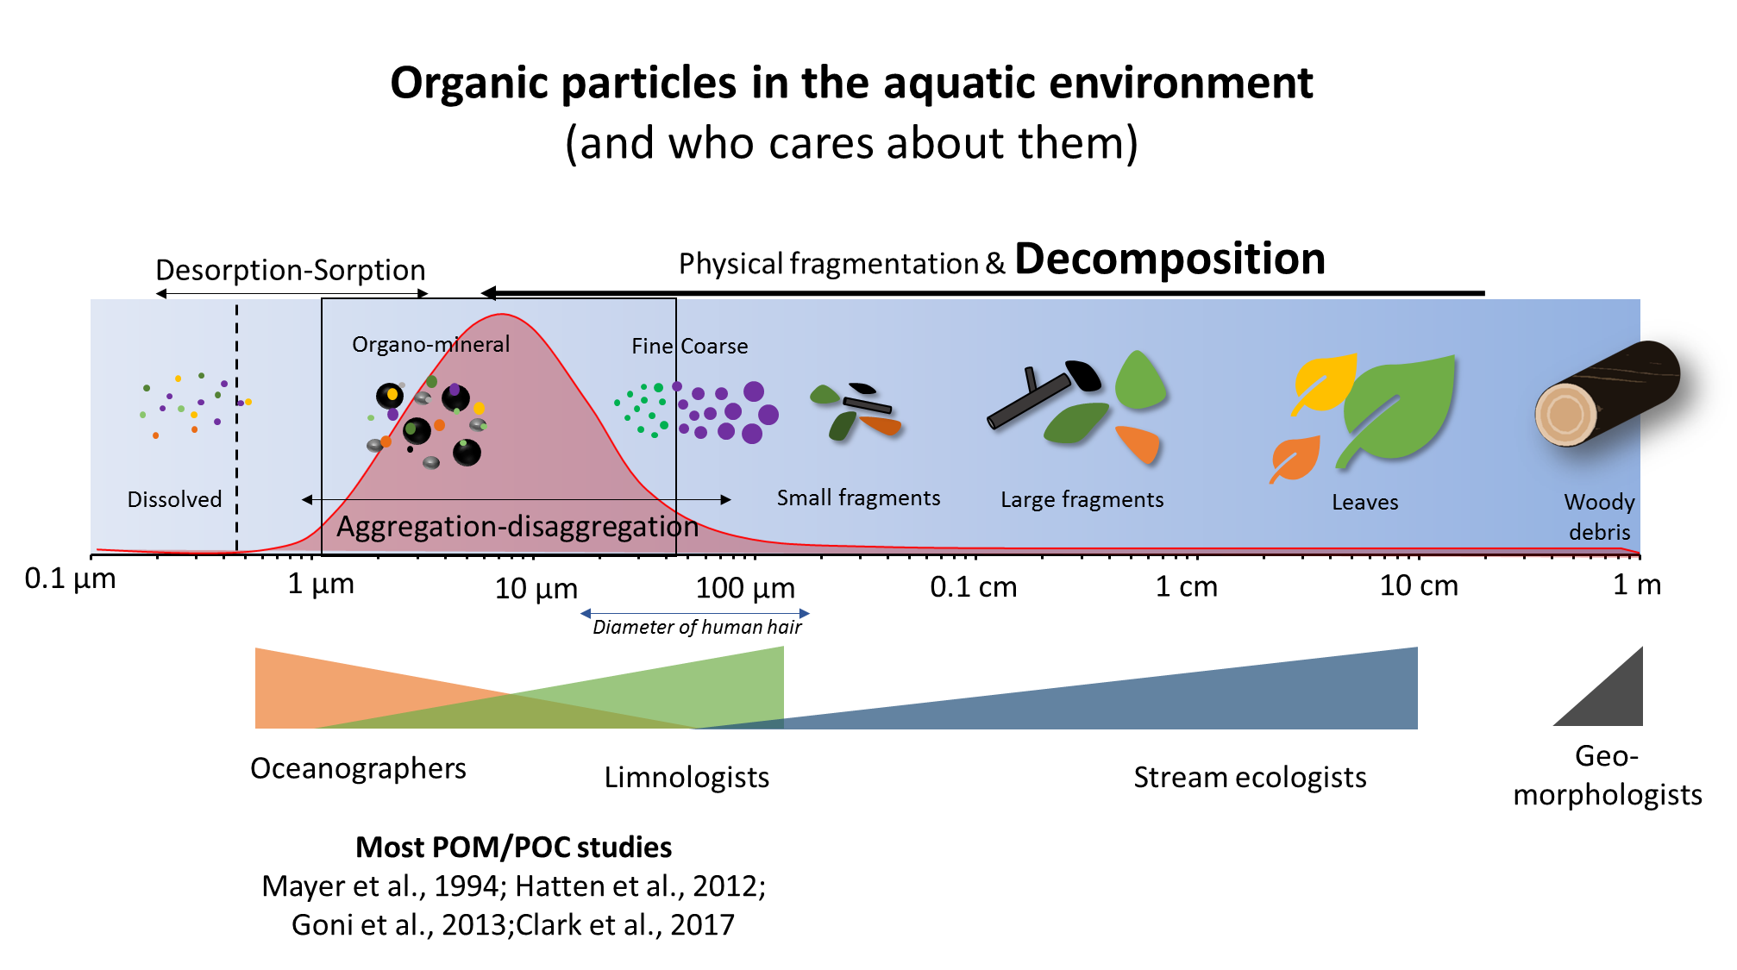
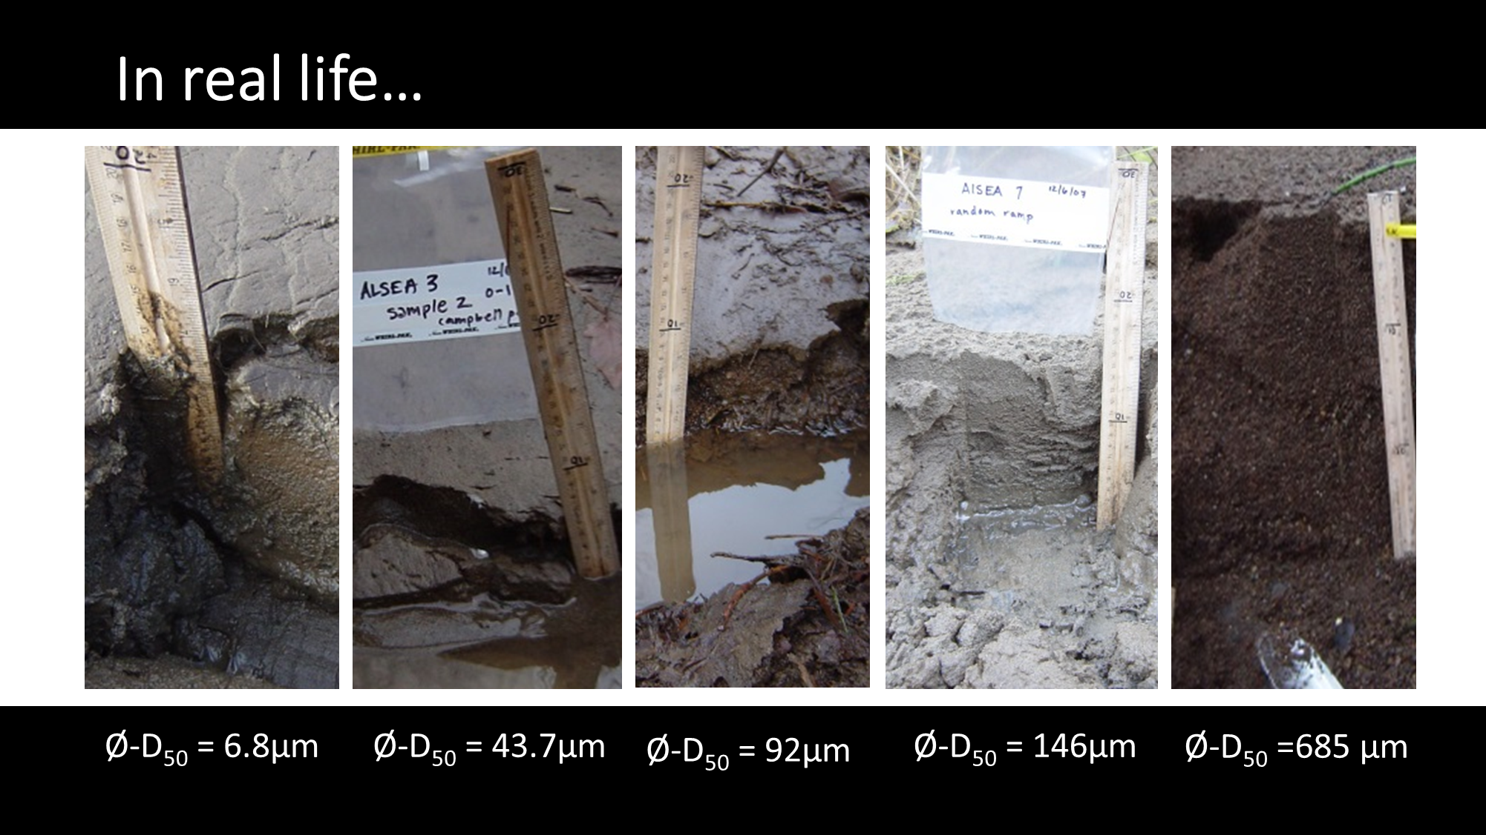
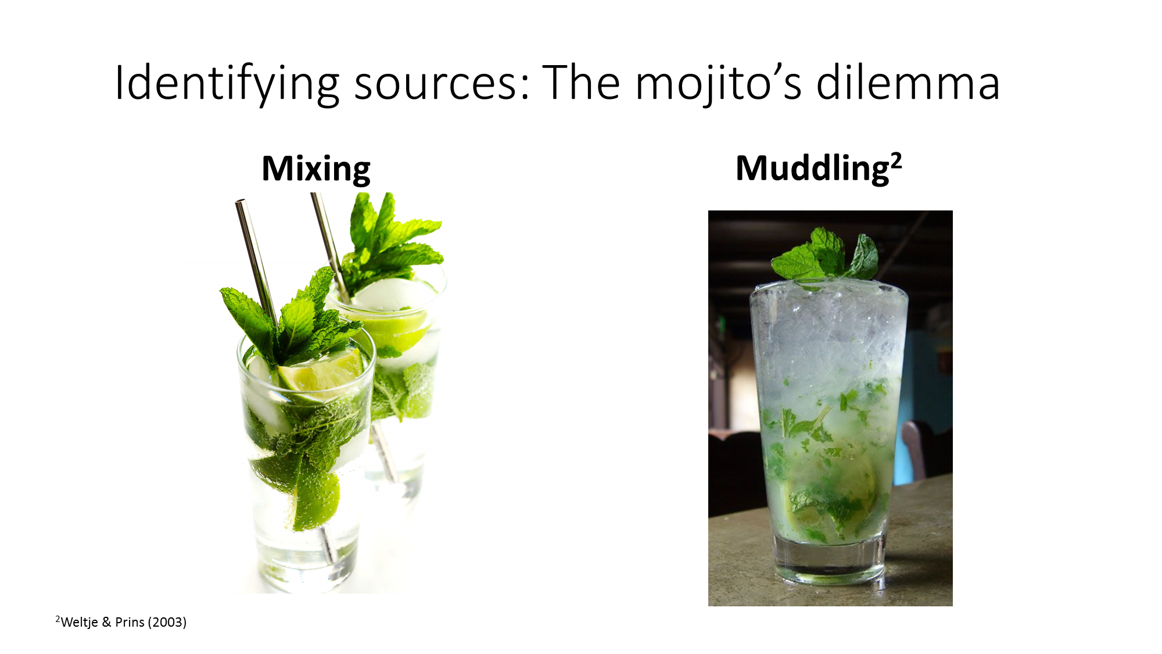
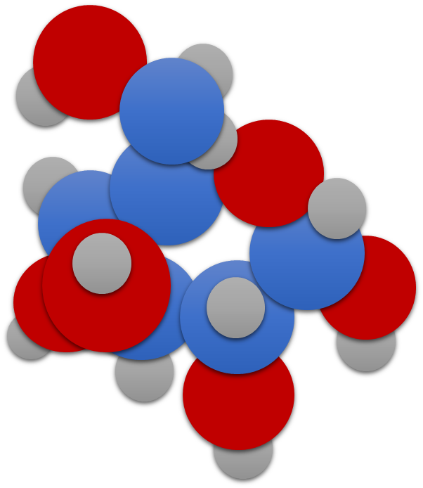
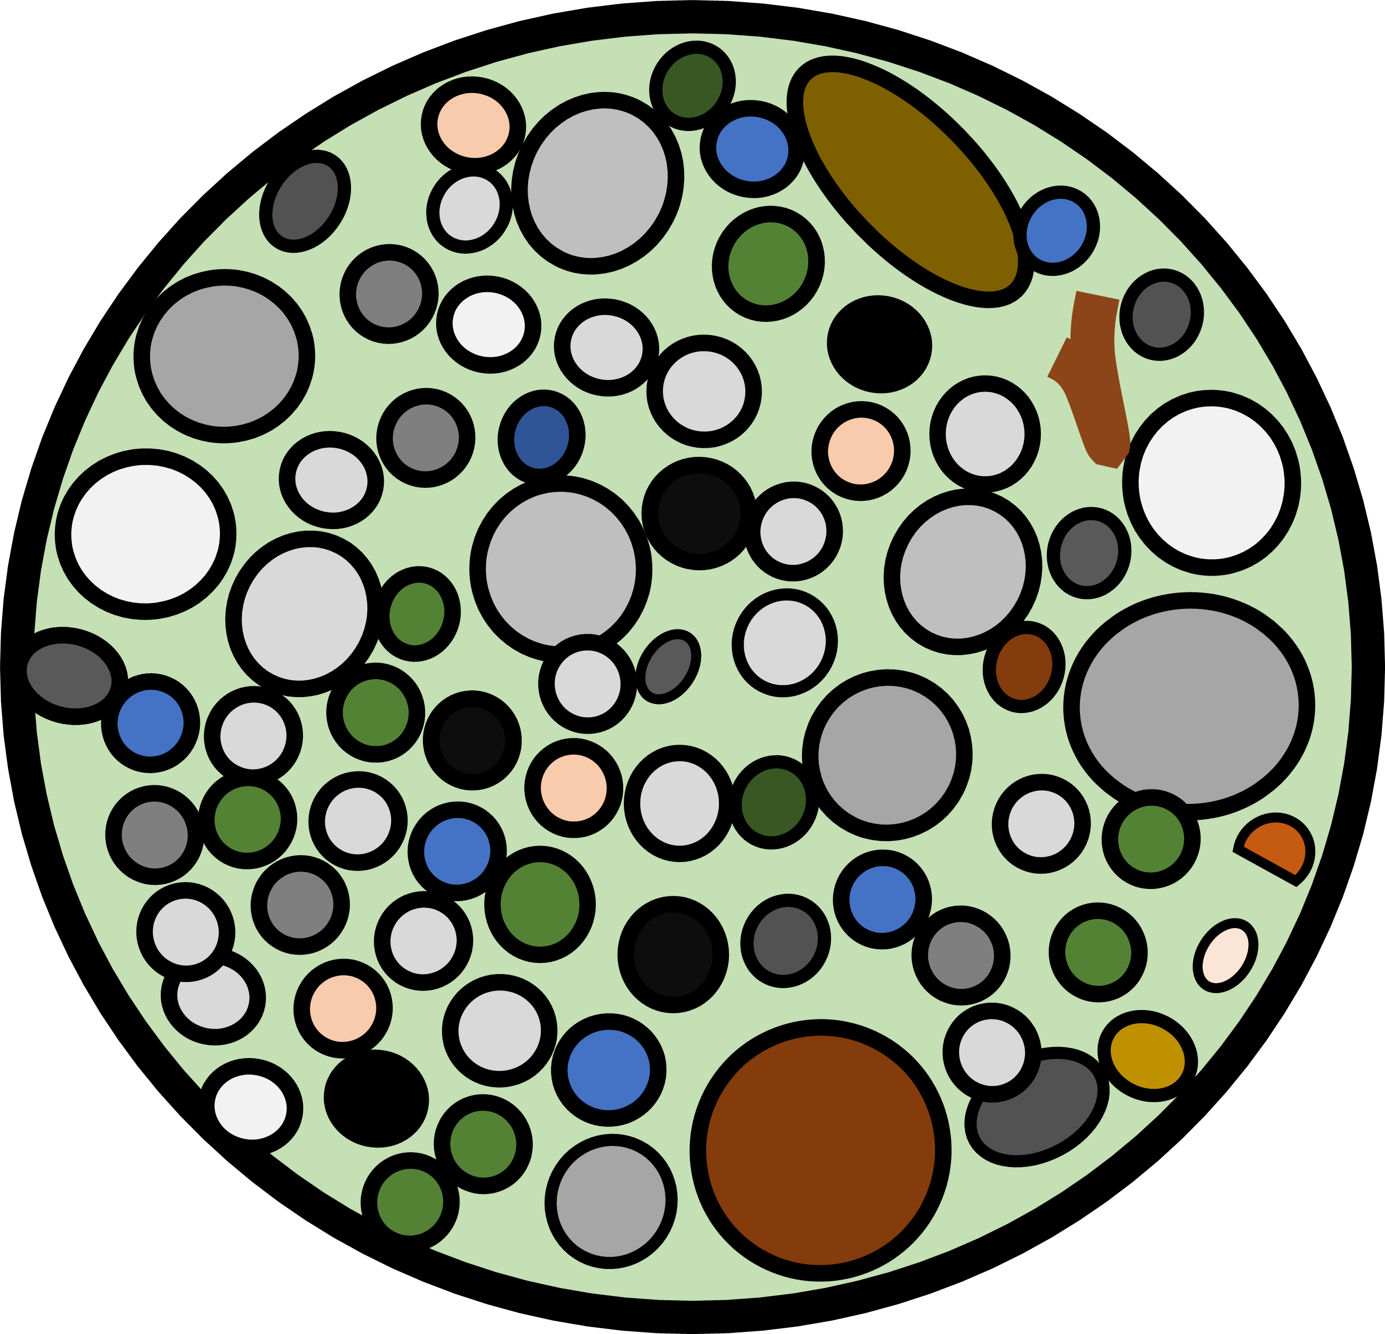
Terrestrial-aquatic carbon fluxes in forested watersheds
“Advanced” sediment
chemistry (e.g., stable
isotopes ratios)
Basic sediment
chemistry (e.g. %C,
N/C ratios )
Diversity of particle
sizes

Slide 13

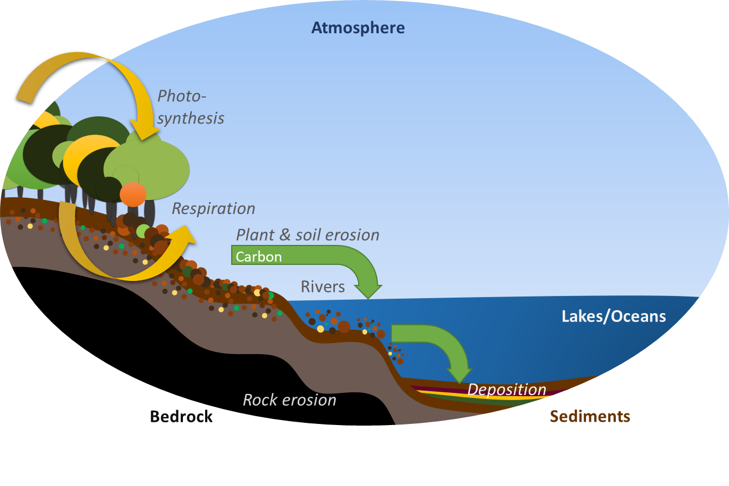





Terrestrial-aquatic carbon fluxes in forested watersheds
Historical Disturbances
Landslides
Earthquakes
Fires
Floods
?
Contemporary
Timber Harvesting
By F. Guerrero
Notes:
Let’s Go to MURAL:https://app.mural.co/t/oregonstate7865/m/oregonstate7865/1633490816640/d4bb0b3a22cff97d9a8b8b4e0a06a005386fa1f0?sender=uaa06939fbabfc43444e21792

Slide 14
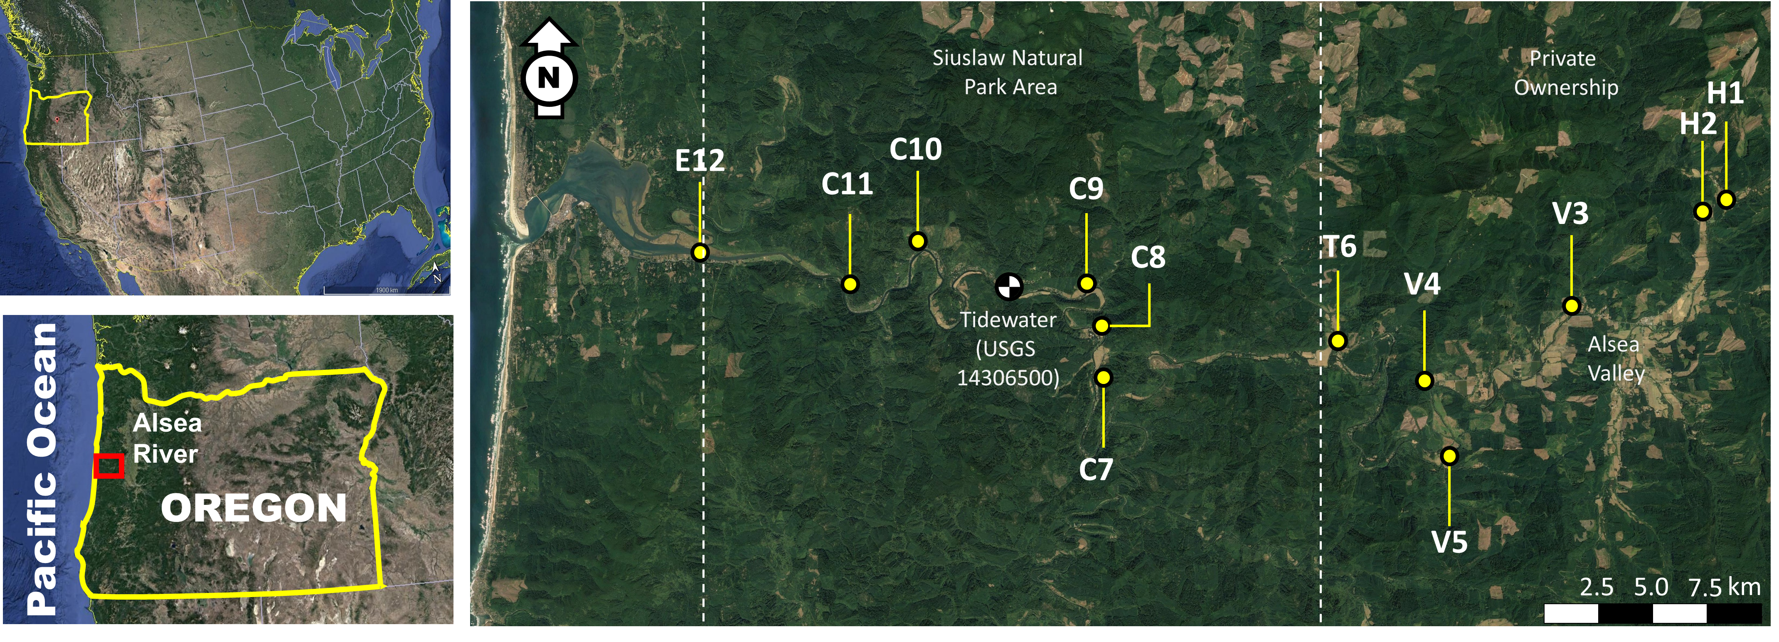
Sampling along the Alsea River after the Great Coastal Gale in 2007
Guerrero et al 2022., In preparation

Slide 15
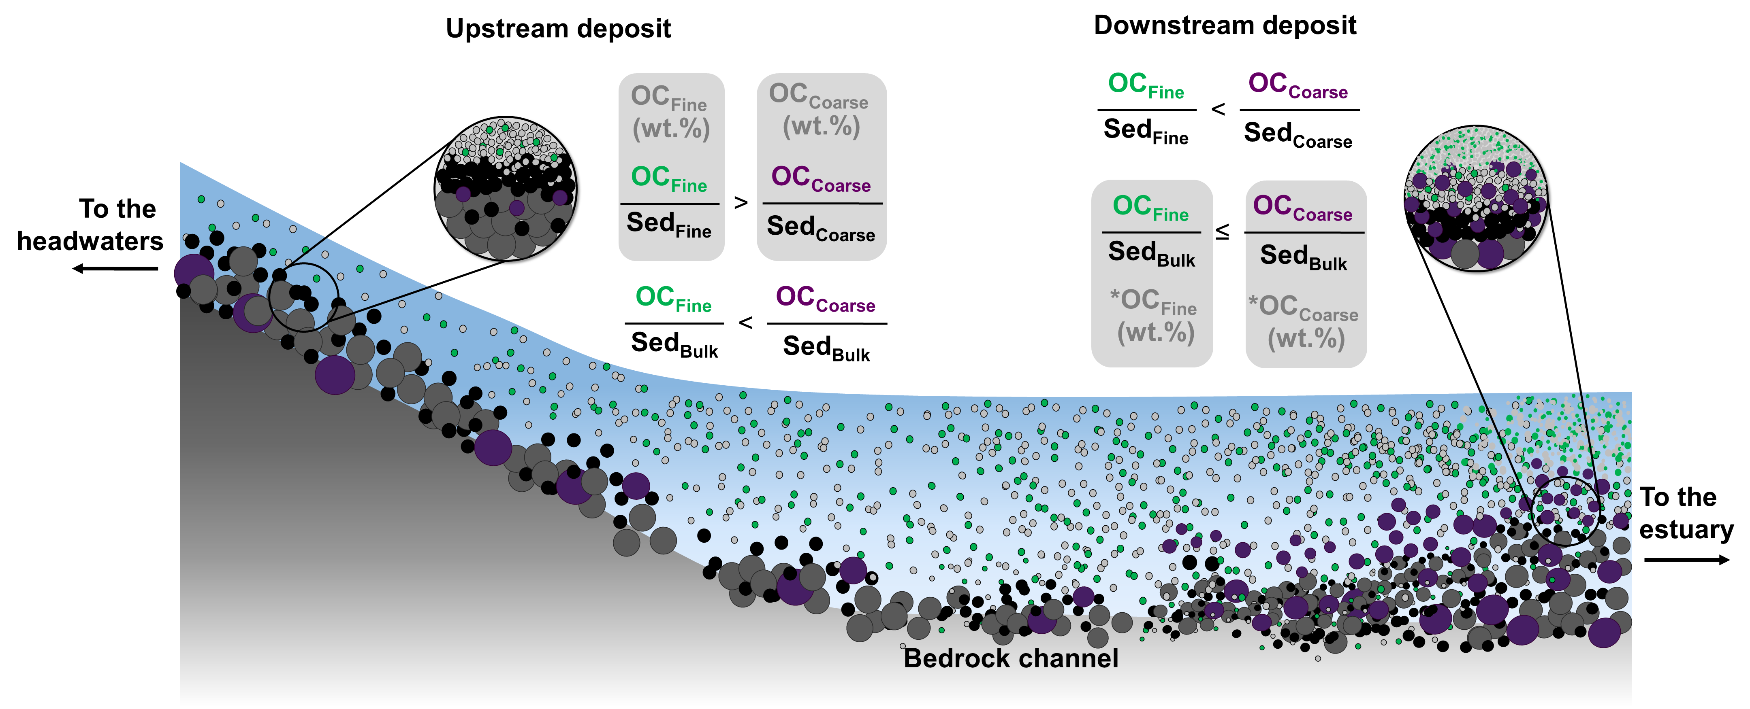
Guerrero et al 2022., In preparation

Slide 16
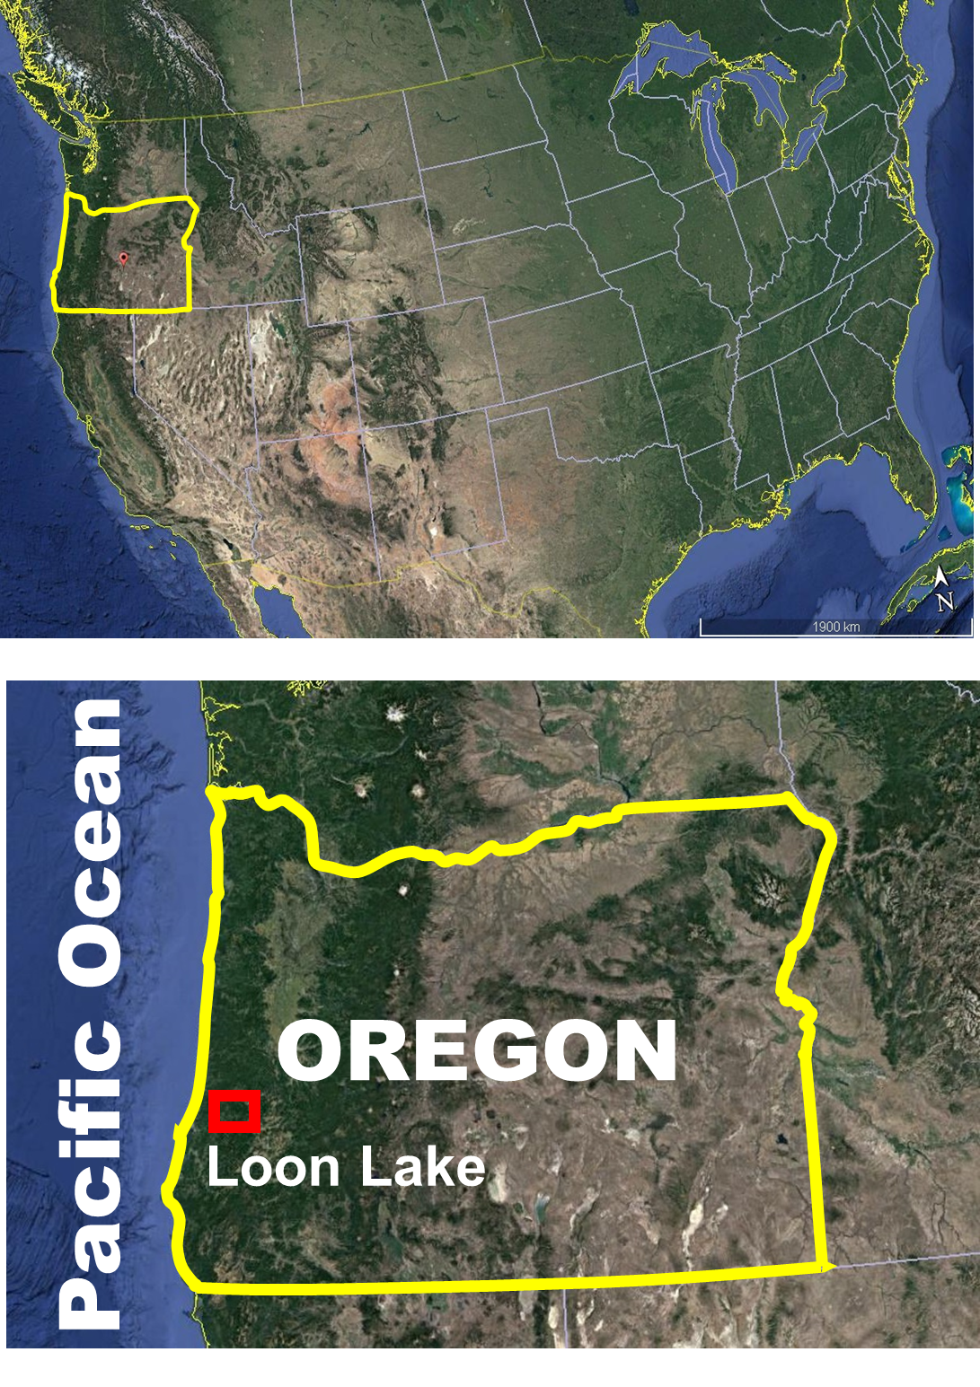
Loon Lake Watershed’s Study
Loon Lake, Southern Oregon (Watershed area: 230 km², Umpqua river)
~1500 years well-preserved record (7m sediment core)

Slide 17
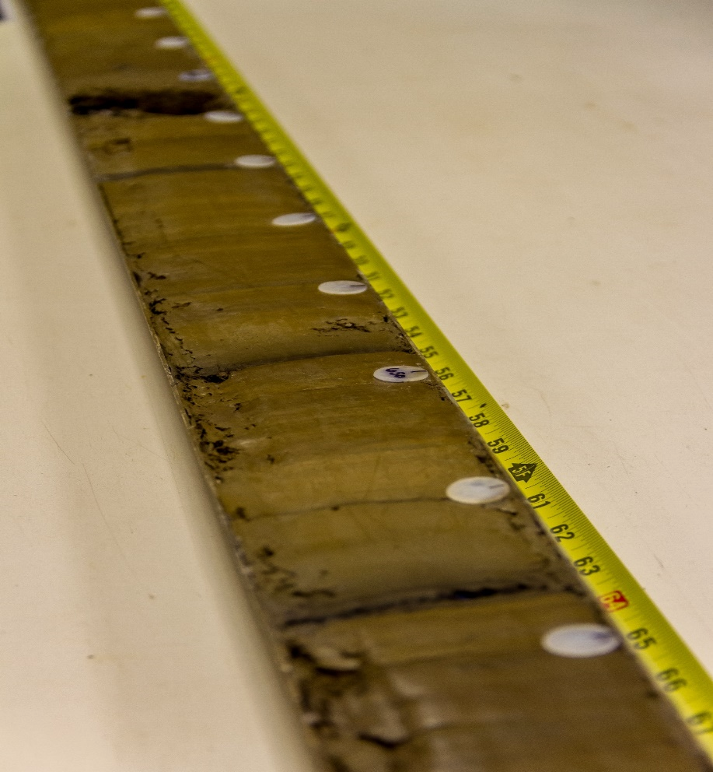
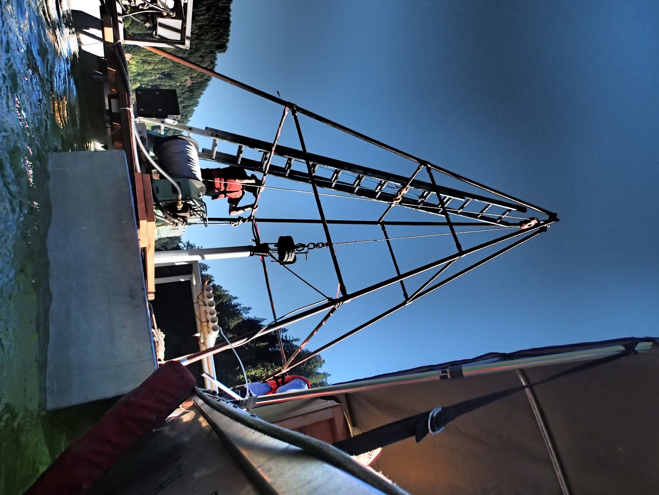
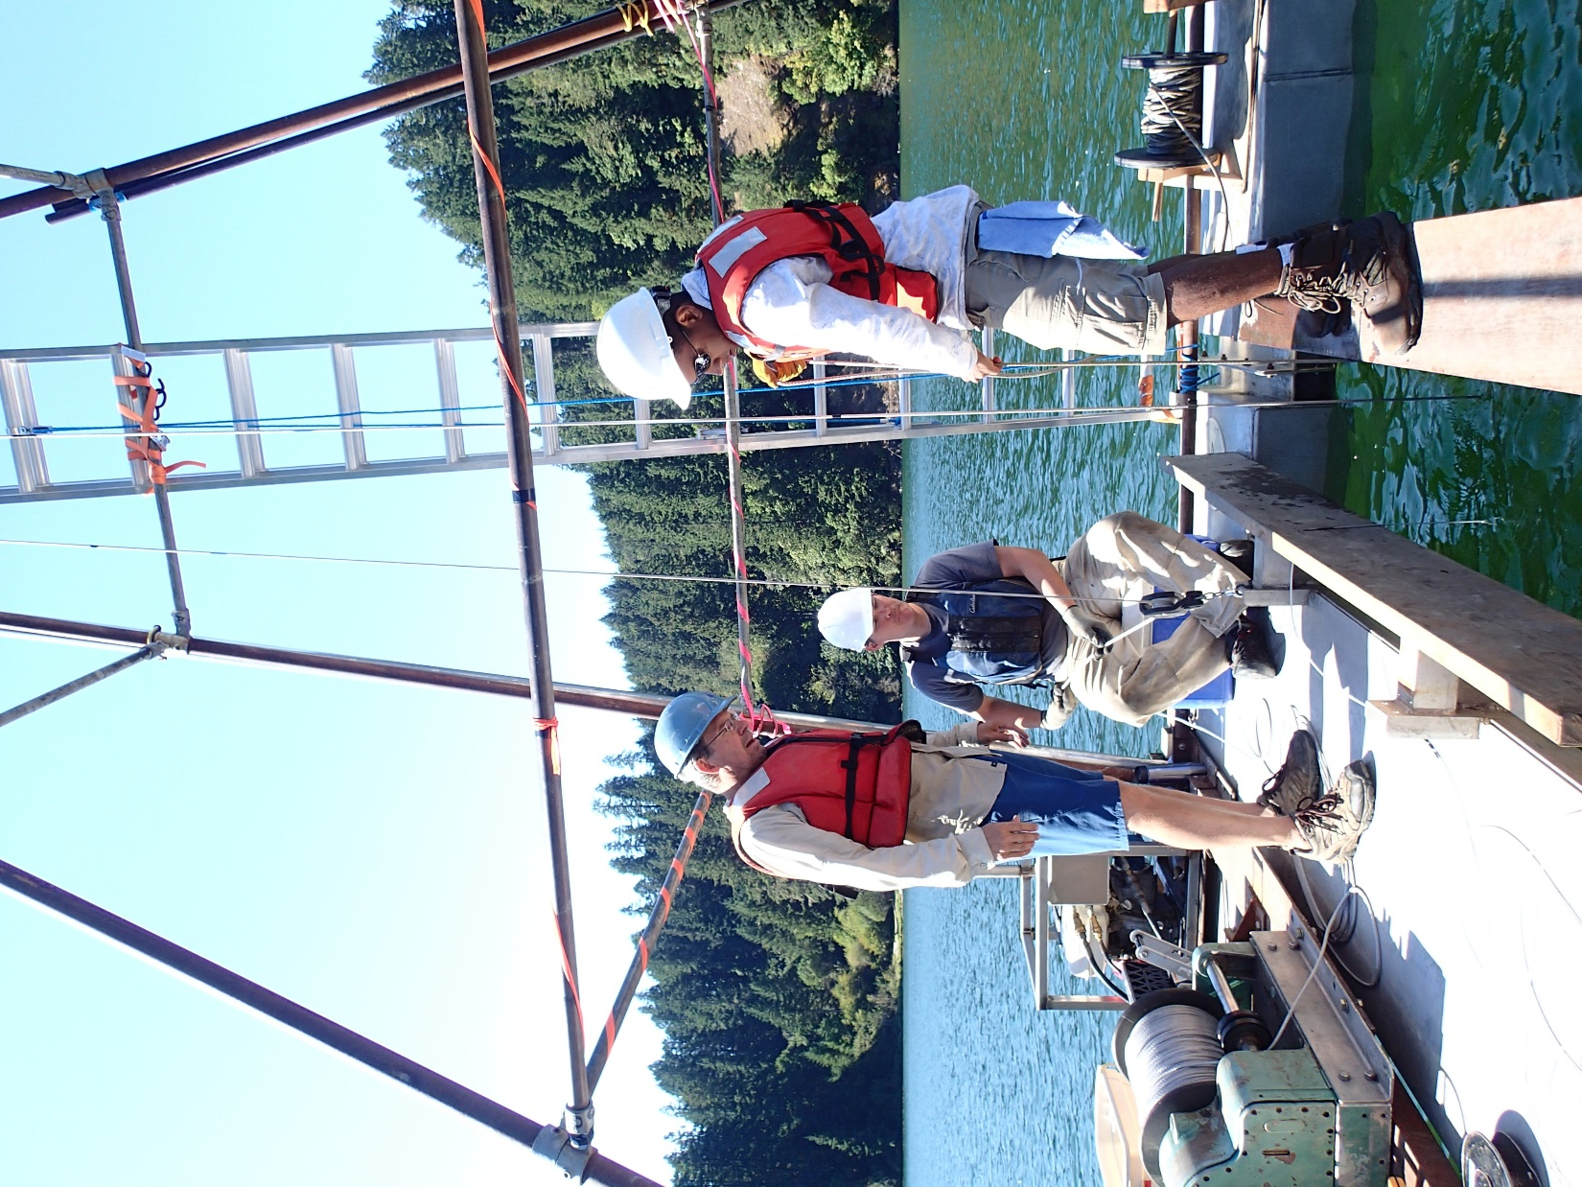
Loon Lake Watershed’s study
Sediment layers
By Phillipe Aulie

Slide 18
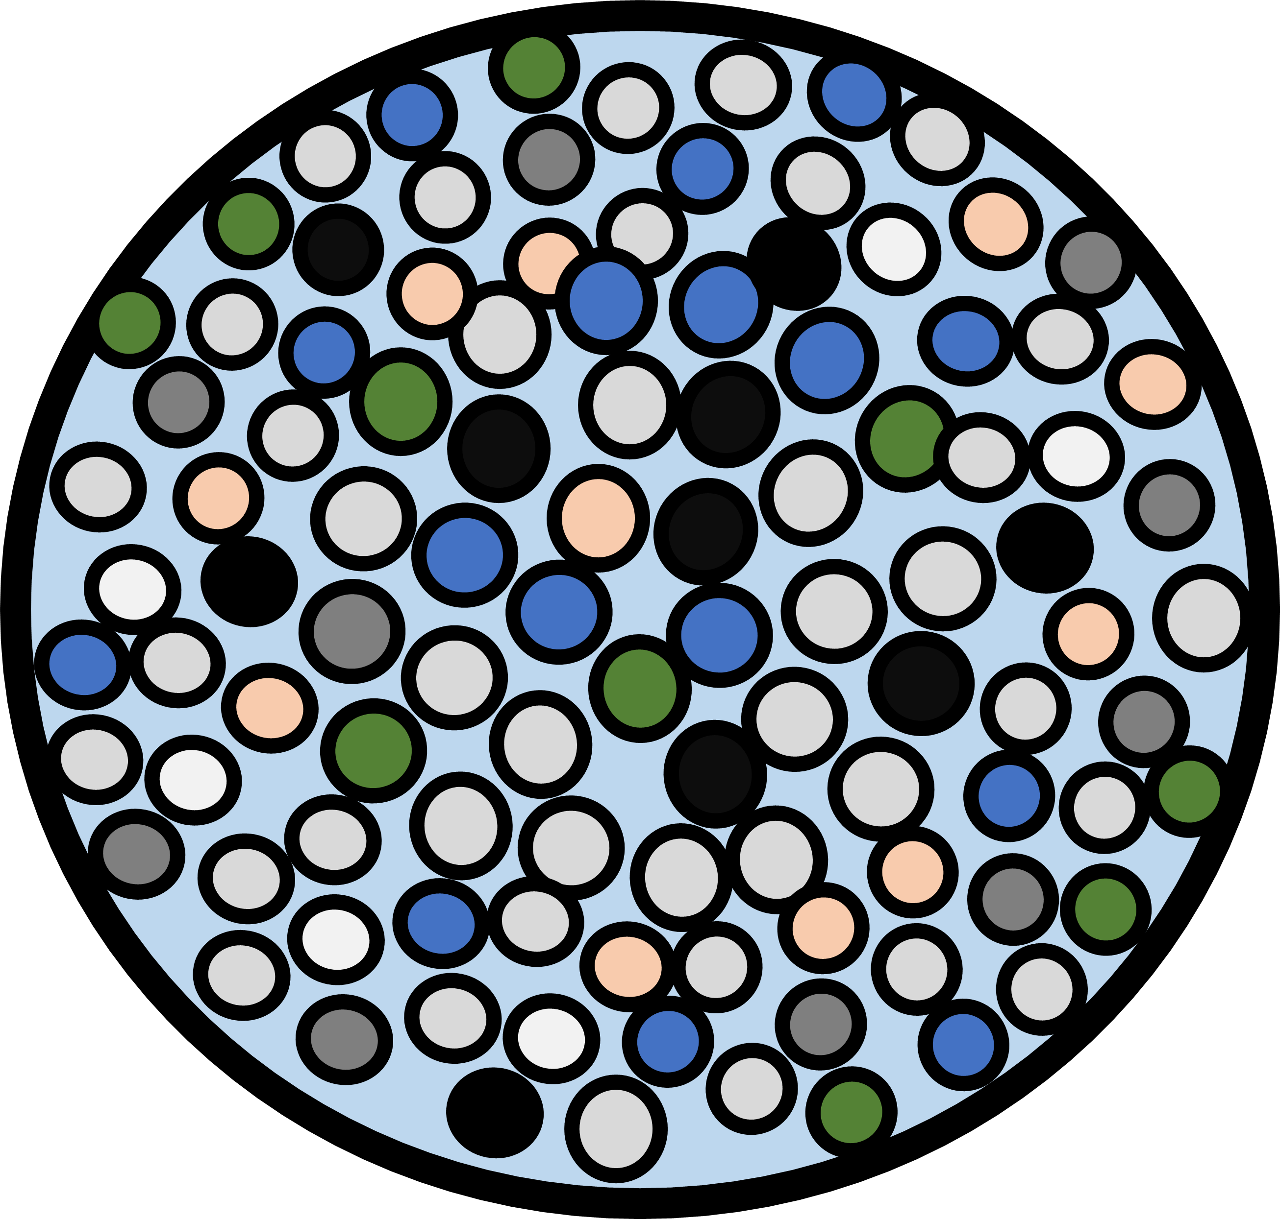
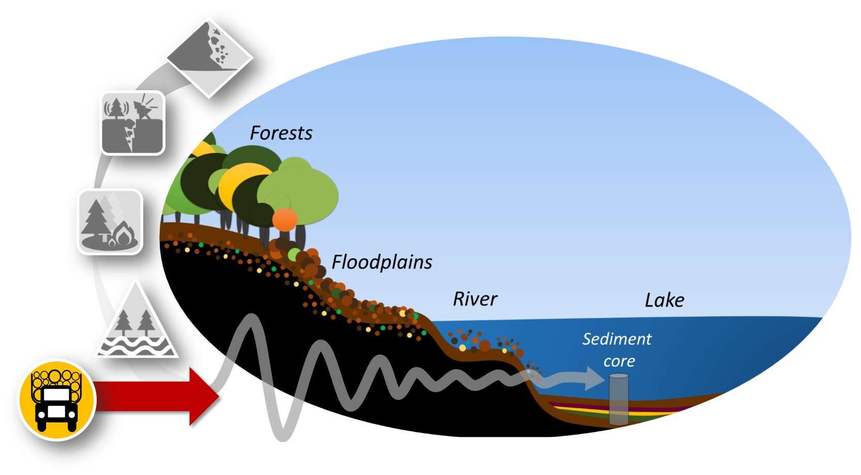

A sedimentary hard-drive
Flood
0100
Landslide
010011
Earthquake
By F. Guerrero
01001100101

Slide 19
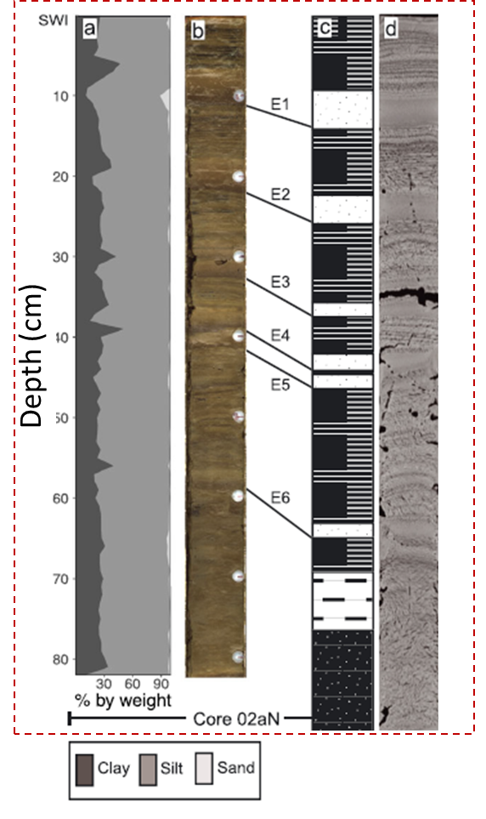
Sample
Count
Count
Particle size (µm)
Particle size (µm)
From Richardson et al., 2018

Slide 20

% Vol.
10.0
Percentage volume (%)
7.5
5.0
2.5
0.0
Particle size (µm) [Log-Scale]
From Richardson et al., 2018

Slide 21

% Vol.
10.0
Percentage volume (%)
7.5
5.0
2.5
0.0
Particle size (µm) [Log-Scale]
From Richardson et al., 2018

Slide 22
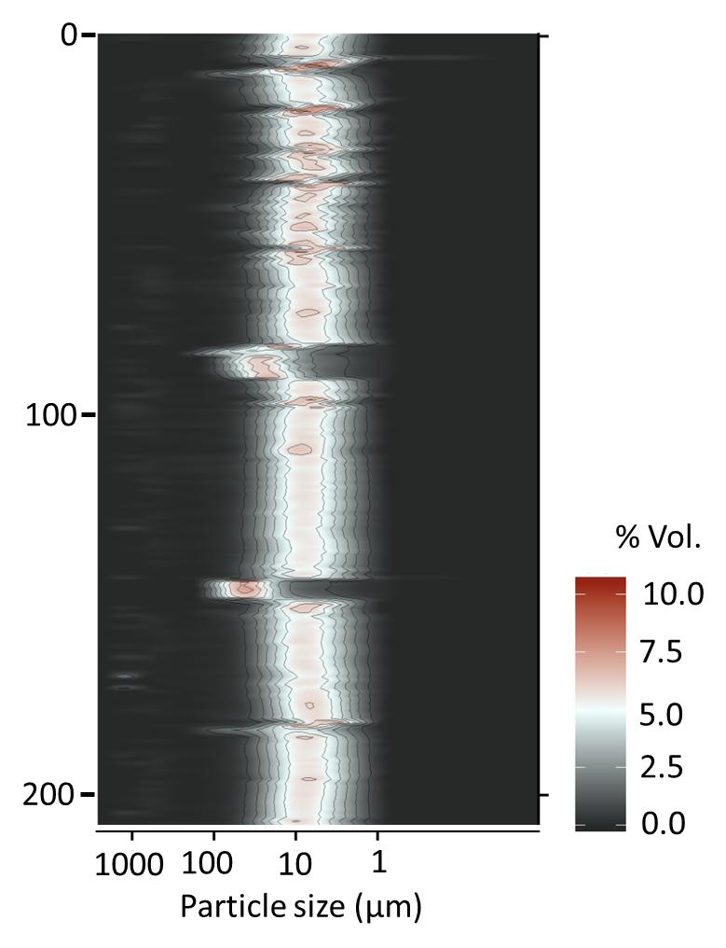
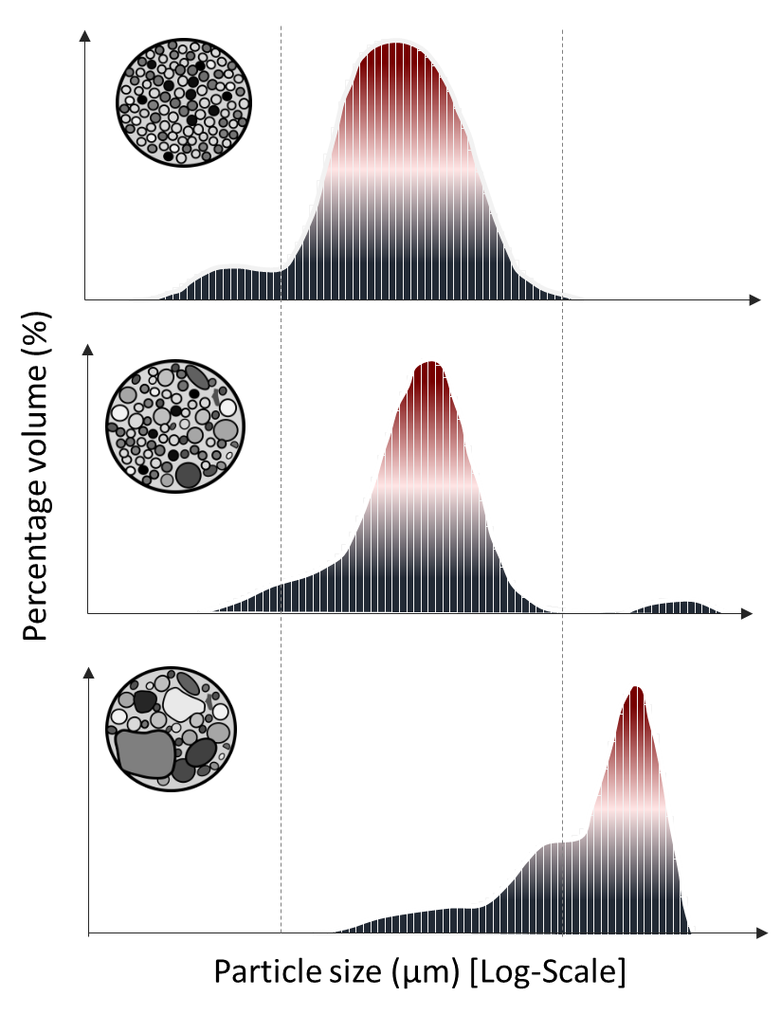
z₁ (cm)
z₂ (cm)
z₃ (cm)
Particle size (µm) [Log-Scale]
From Richardson et al., 2018

Slide 23
z₁ (cm)
Newer
Time
z₂ (cm)
Older
z₃ (cm)
Particle size (µm) [Log-Scale]

Slide 24
A sedimentary hard-drive
Flood
0100
Landslide
010011
Earthquake
By F. Guerrero
01001100101

Slide 25
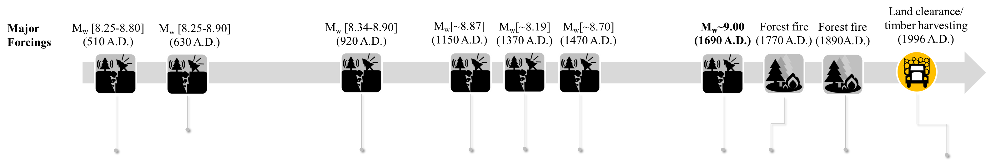
1945
Guerrero et al 2022., In preparation

Slide 26
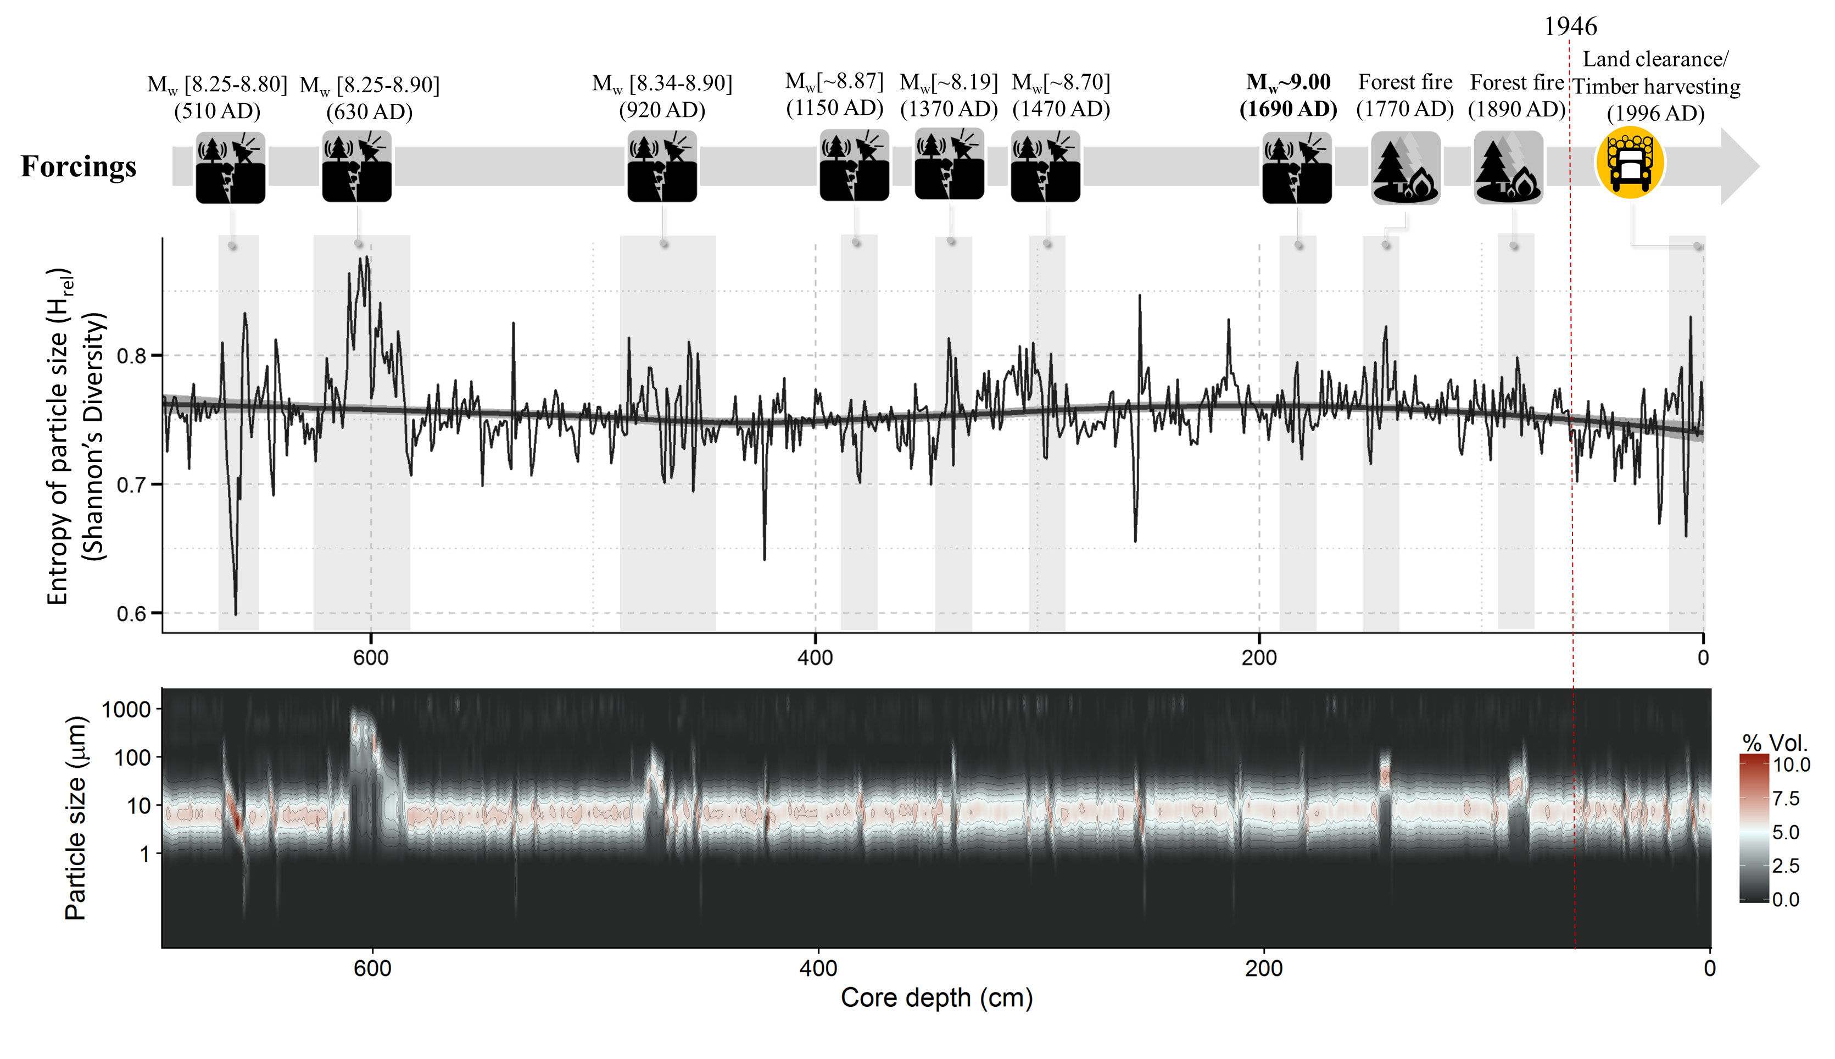
1945
Guerrero et al 2022., In preparation

Slide 27
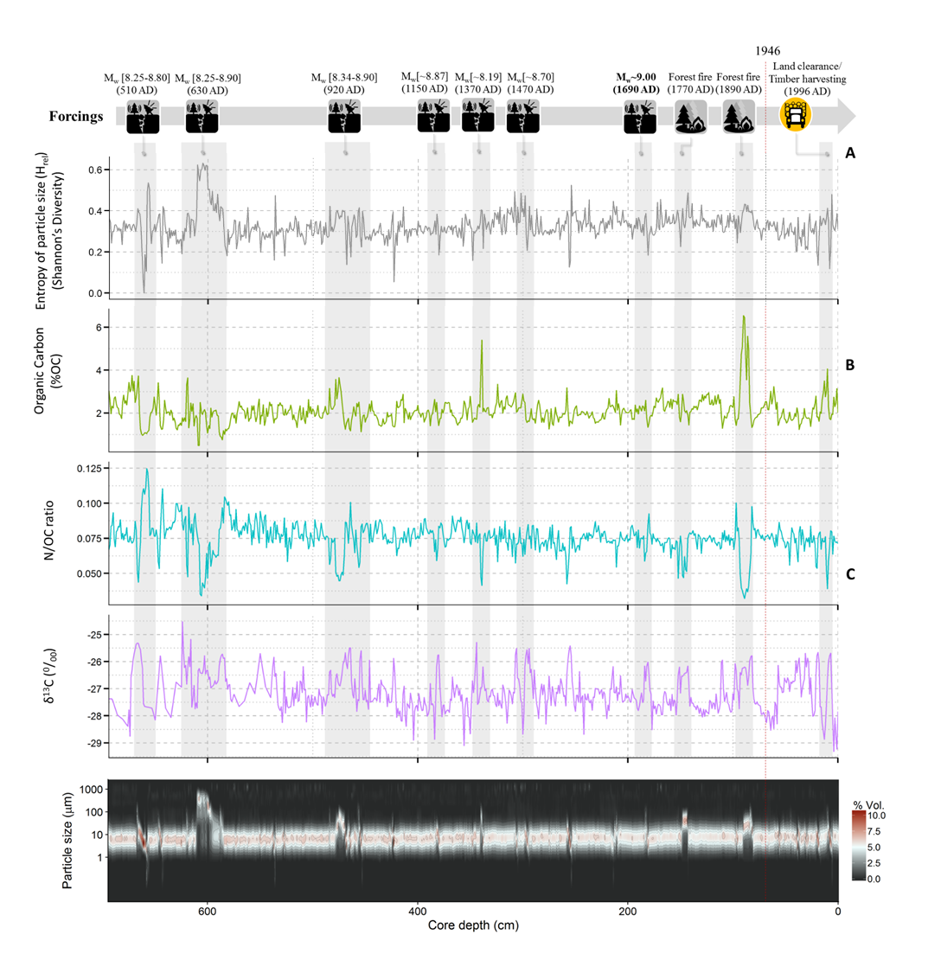
Guerrero et al 2022., In preparation

Slide 29
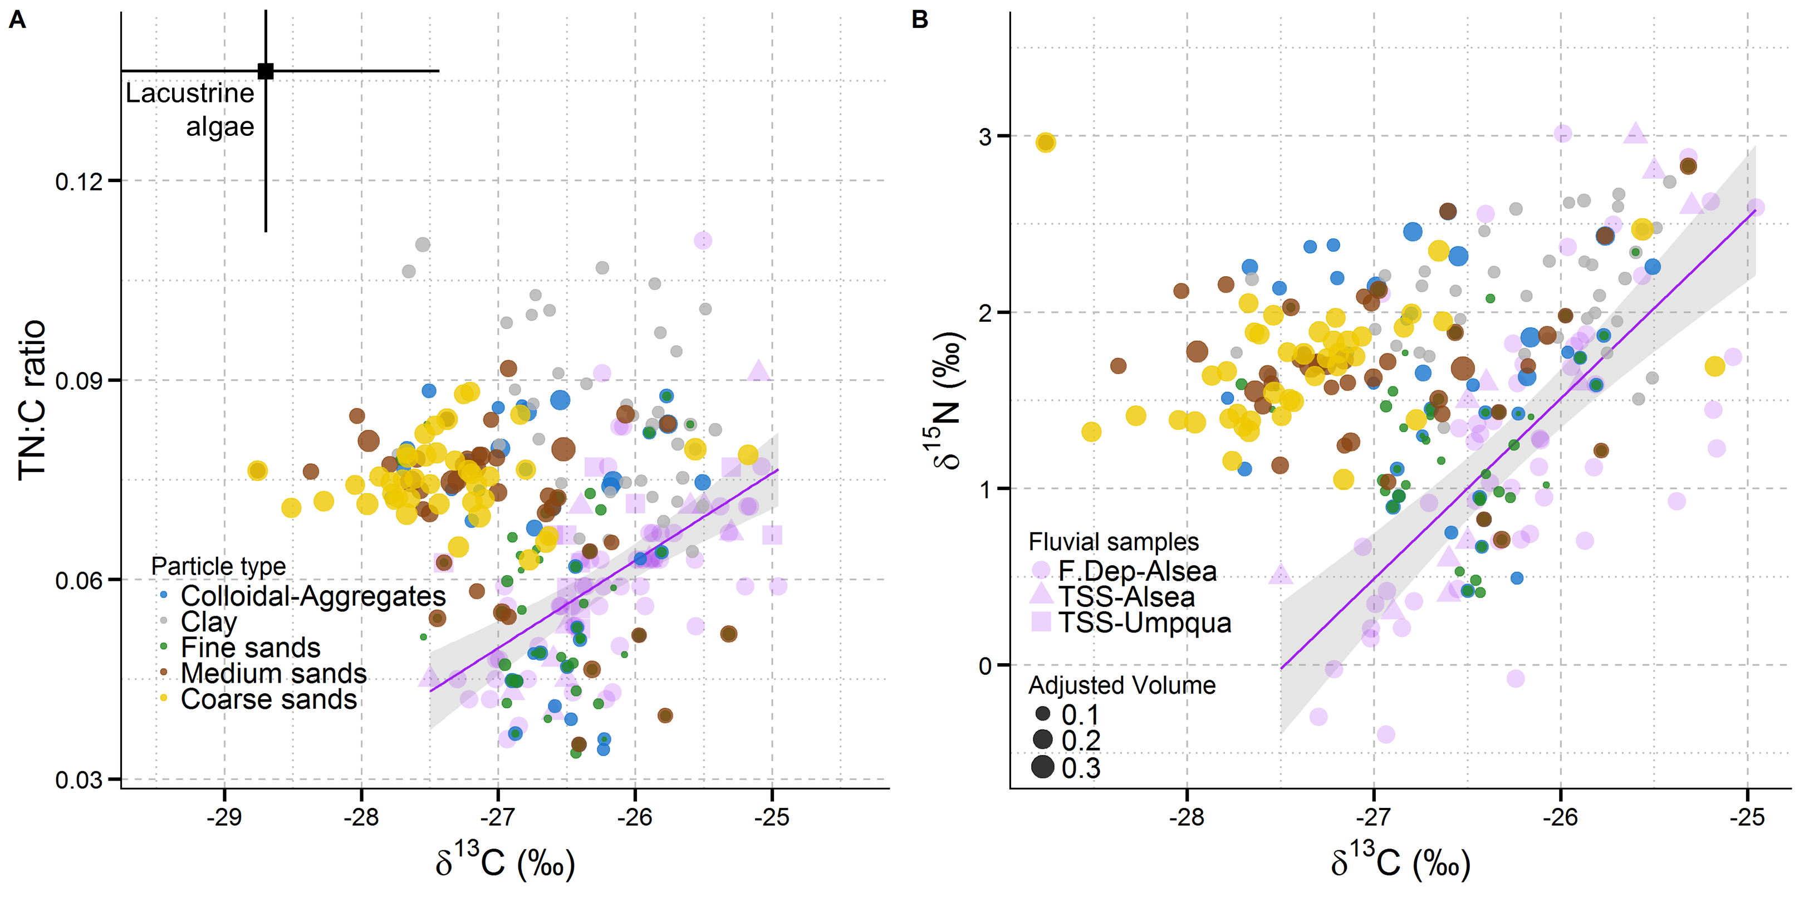
Hacking sedimentary enigmas: information leftovers
Fluvial
TSS
Fluvial
TSS
Guerrero et al 2022., In preparation

Slide 30
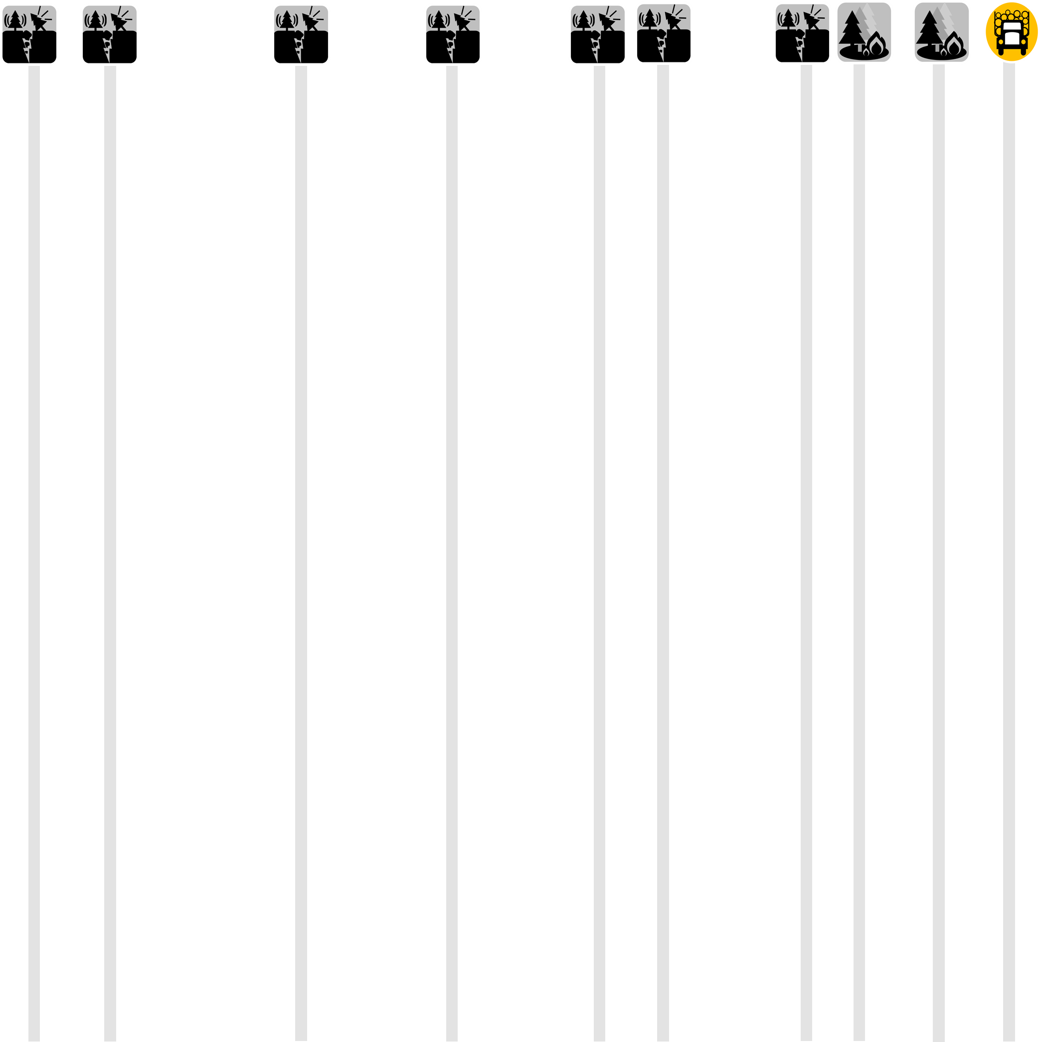
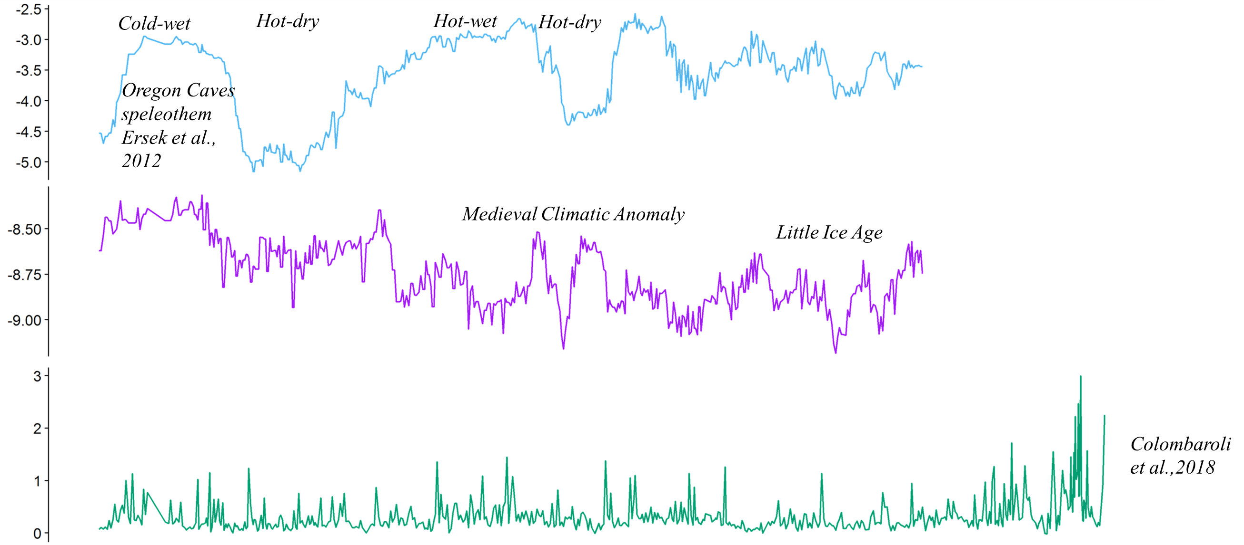
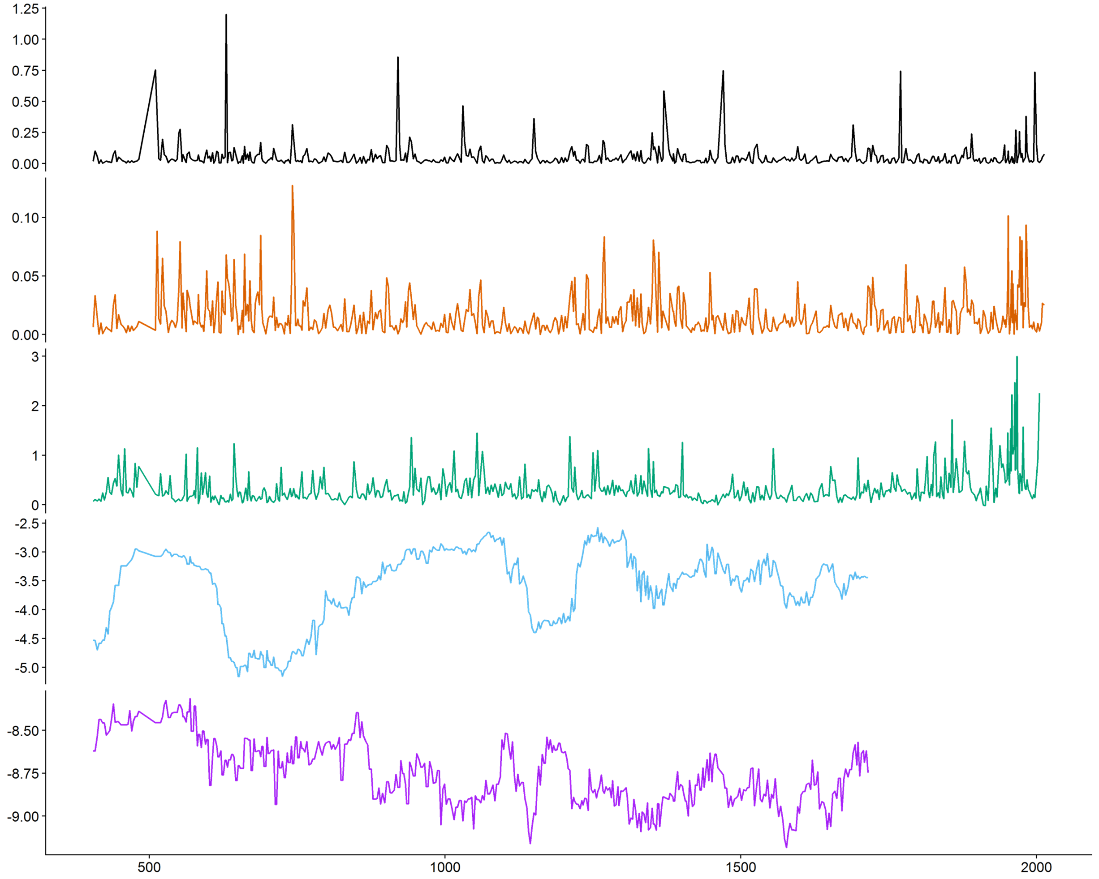
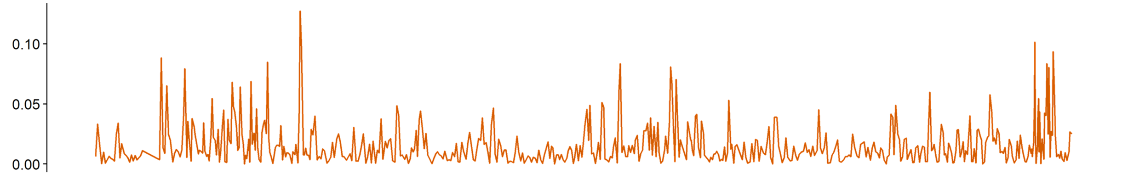
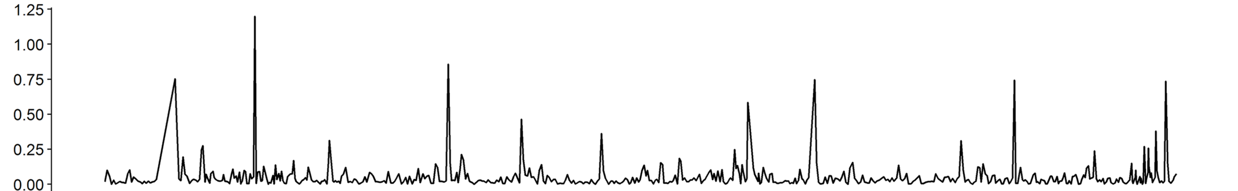
Precipitation
proxy
Temperature
proxy
Sedimentation
proxy
Year AD
Entropy y-¹
(Average)
This is us…
Entropy y-¹
(Total)
Guerrero et al 2022., In preparation
Year AD

Slide 31
Earthshaking Forestry?
Historical
Disturbances
Terrestrial-aquatic carbon fluxes in forested watersheds
Landslides
Earthquakes
Post-WWII timber harvesting in the Oregon
Coast Range resulted in higher lake sedimentation
rates than those produced by natural disturbances
including earthquakes
Fires
Floods
?
?
Contemporary
Timber Harvesting

Slide 33
Should we bury our forests in the bottom of the ocean?
Francisco J. Guerrero, PhD
College of Forestry
Oregon State University
@fjguerrerob
guerrero.Francisco.jose@gmail.com

Slide 35
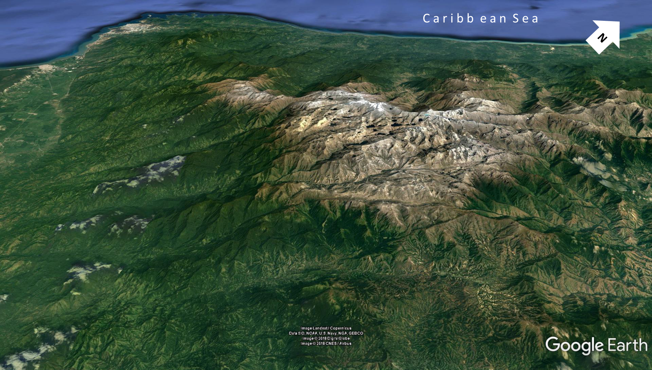
December, 2019

Slide 36
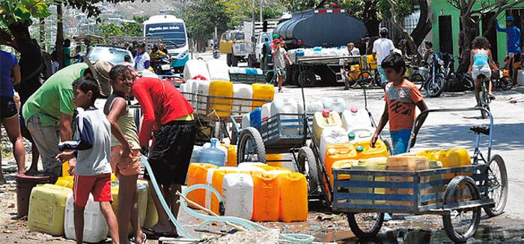
waterwellsofafrica.org

Slide 37
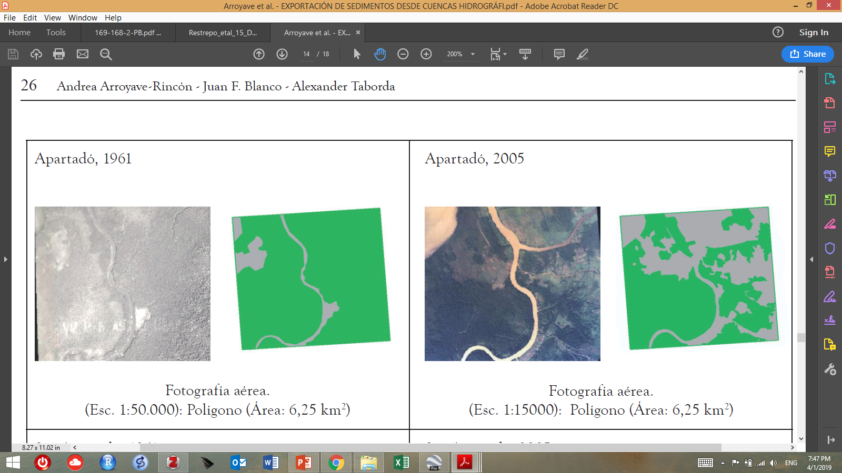

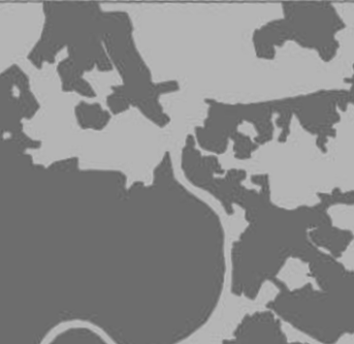
Cambios de cobertura boscosa en Apartado (Uraba Colombiano) entre 1961 y 2005
1961
2005
Cobertura
boscosa
Cobertura
boscosa
Fotografia aerea (Esc. 1:50000)
Poligono (Area: 6.25 km2)
The Magdalena and Atrato rivers are by far the Colombian systems which contribute the highest P and N fluxes to the sea. Causes responsible for these high nutrient loads include massive sewage collection in cities and towns for NH4+ and PO4- 3, mainly in the Magdalena basin, and also due to fertilization of banana plantations in the lower course of the Atrato River. Many Colombian rivers, including the larger Magdalena, are affected by deforestation and rapid changes in land use, thus accelerating the transfer of particulate and dissolved organic and inorganic matter, from the river basins to the sea.

Slide 38
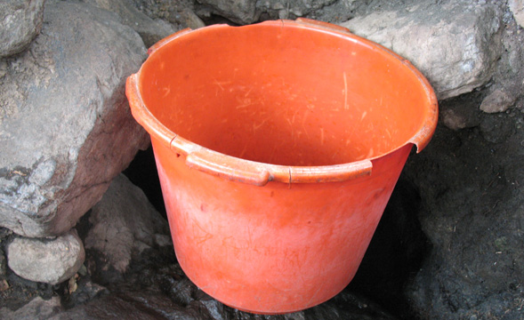
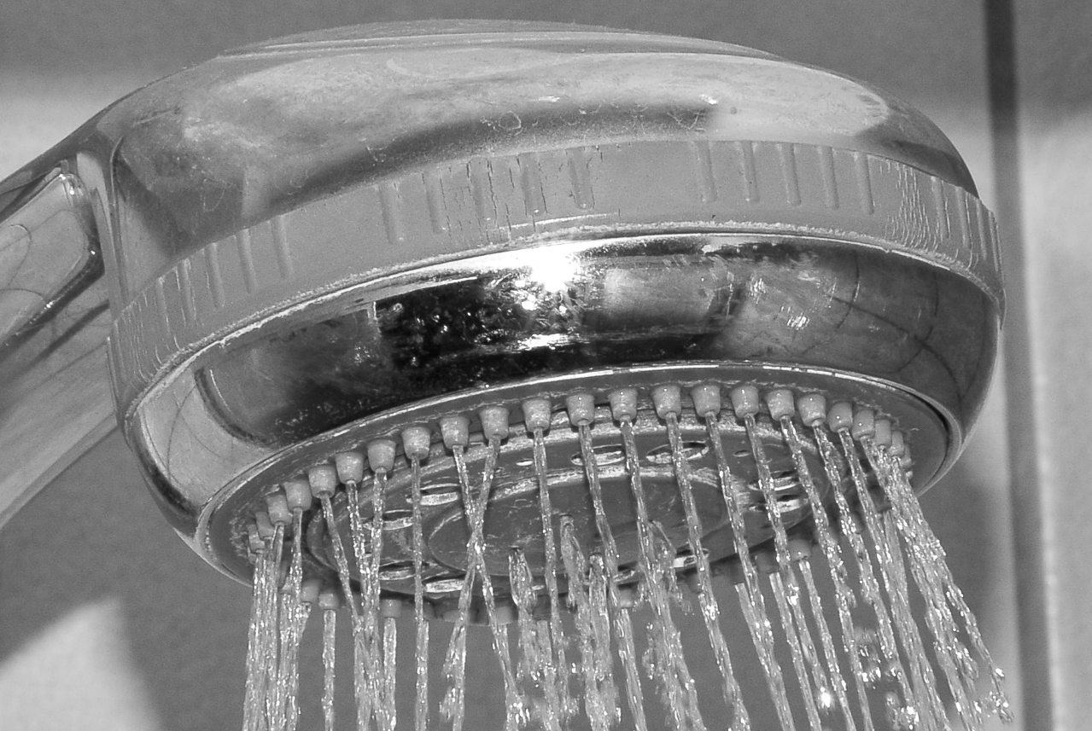

Slide 39
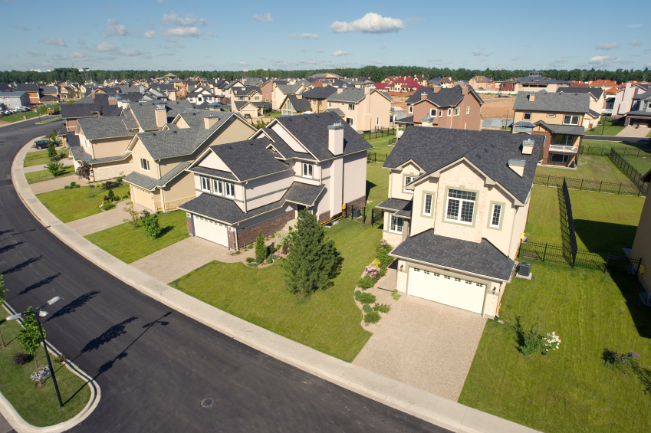
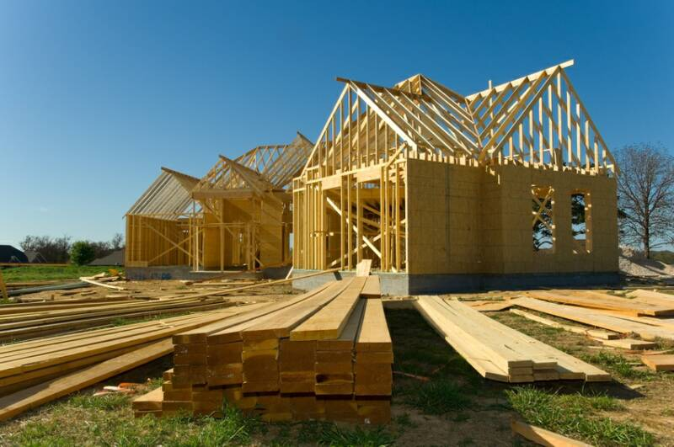


Slide 42
